Slide 1
HD-Insight
arnaud.nauwynck@gmail.com
Course Esilv 2024

Slide 2
Exploring Linux HeadNode Server via SSH

Slide 3
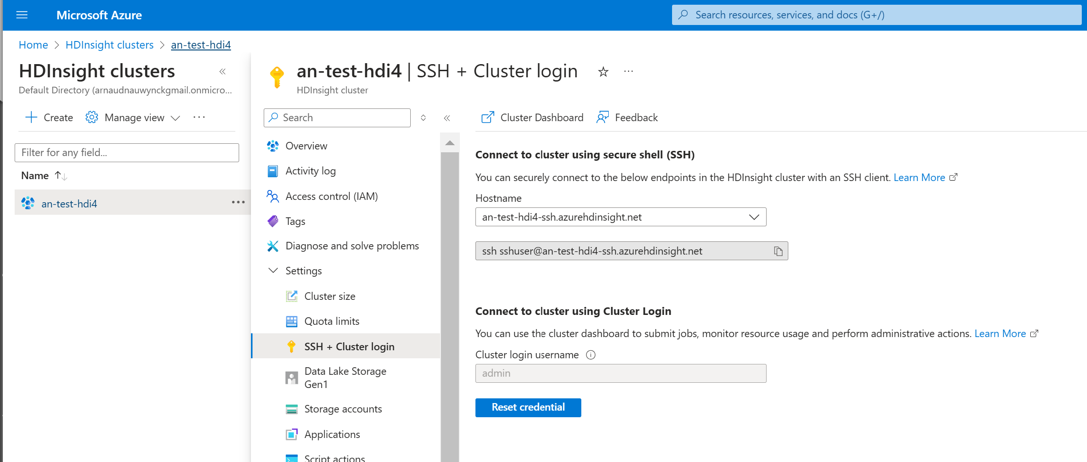
Connecting to SSH on HD-Insight

Slide 4
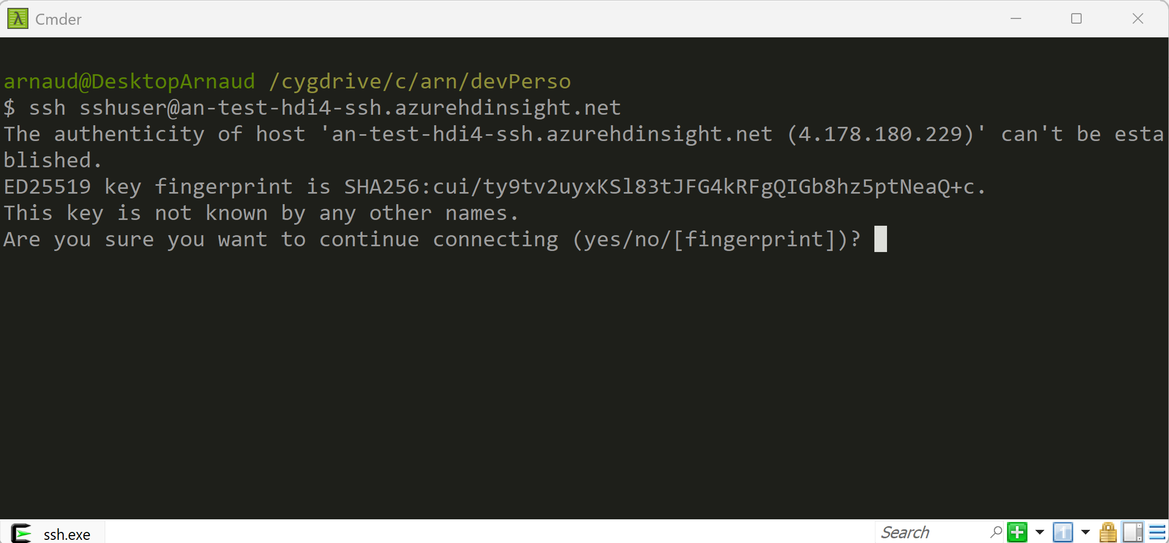
SSH

Slide 5
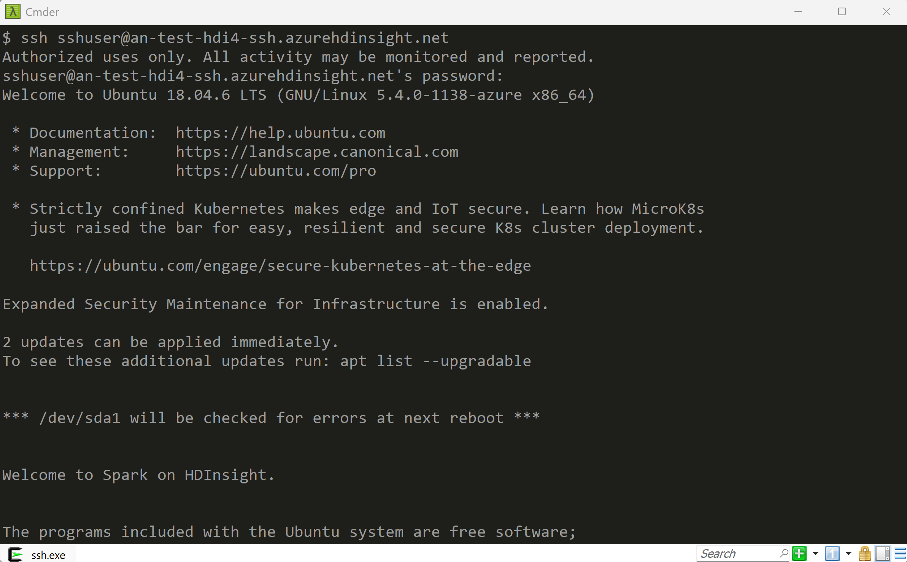
SSH

Slide 6
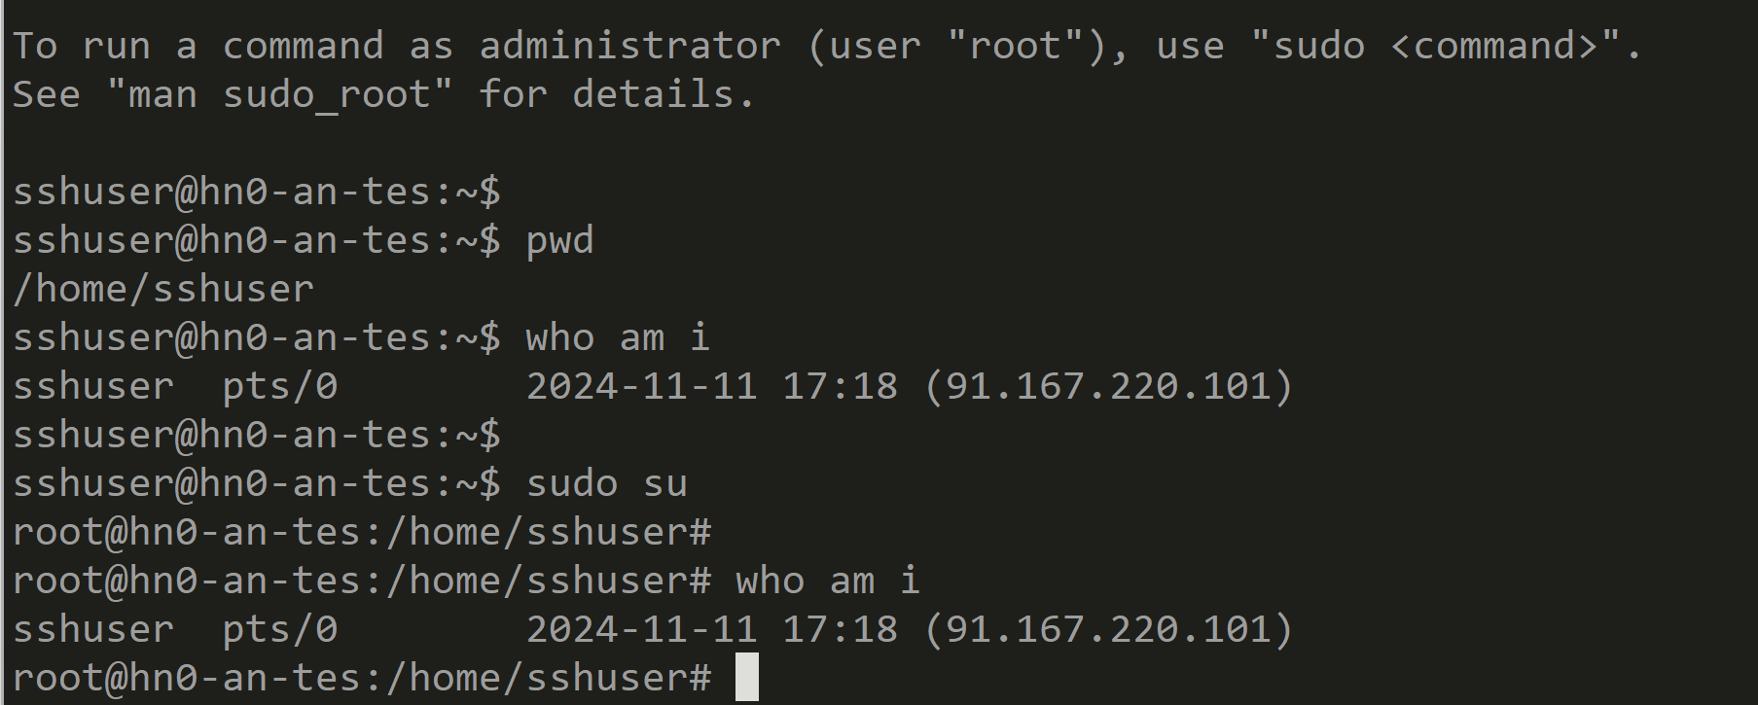
Who am I ... sudo su

Slide 7
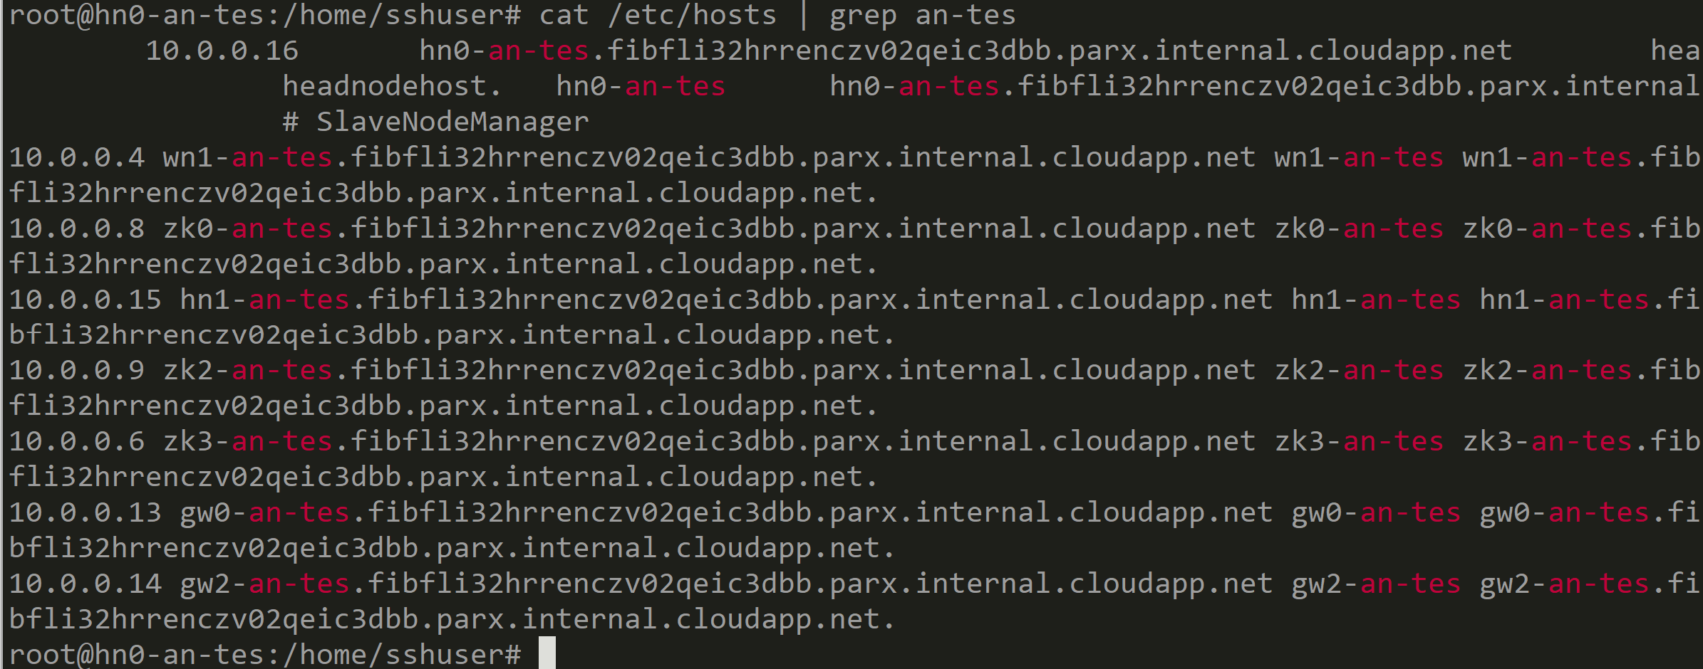
/etc/hosts ... Hostname are using "hn|wn" then cluster name truncated to 6 letters

Slide 8
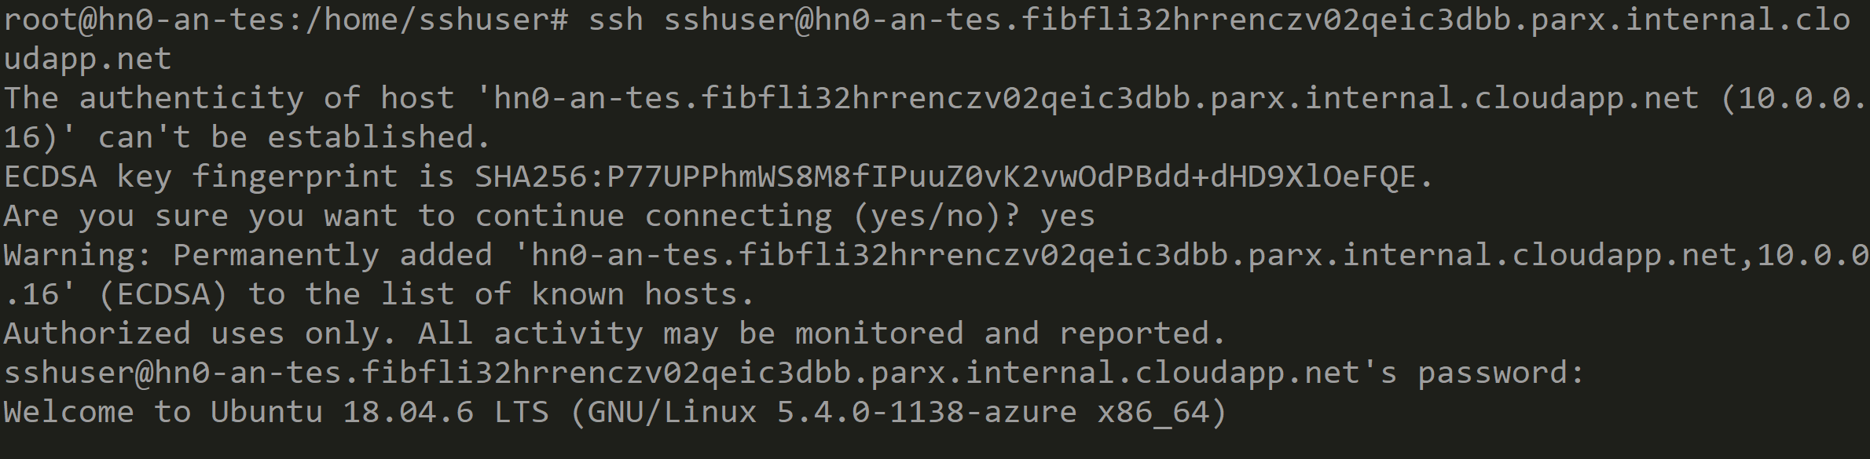
ssh -> ssh on hn0-

Slide 9

Remark: direct SSH to hn0, hn1 ... FAIL need ssh tunnel

Slide 10
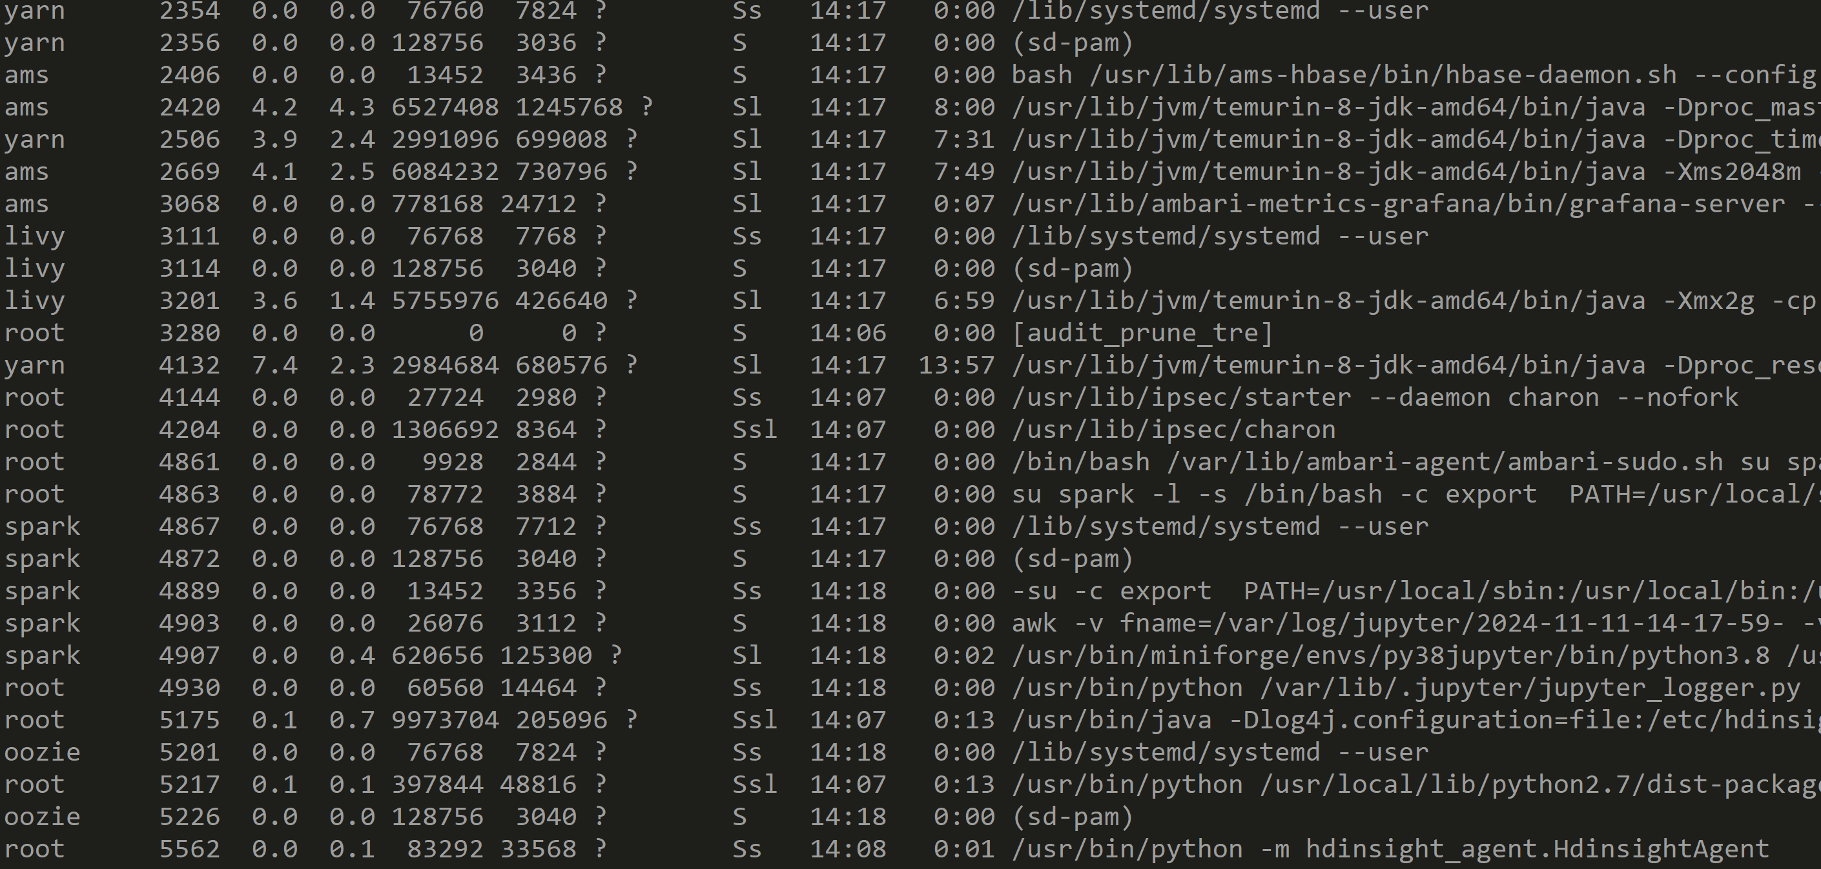
Discovering processes running on hn0 # sudo ps aux

Slide 11
Lot of Java processes .. running as user "yarn", "oozie", livy", ...

Slide 12
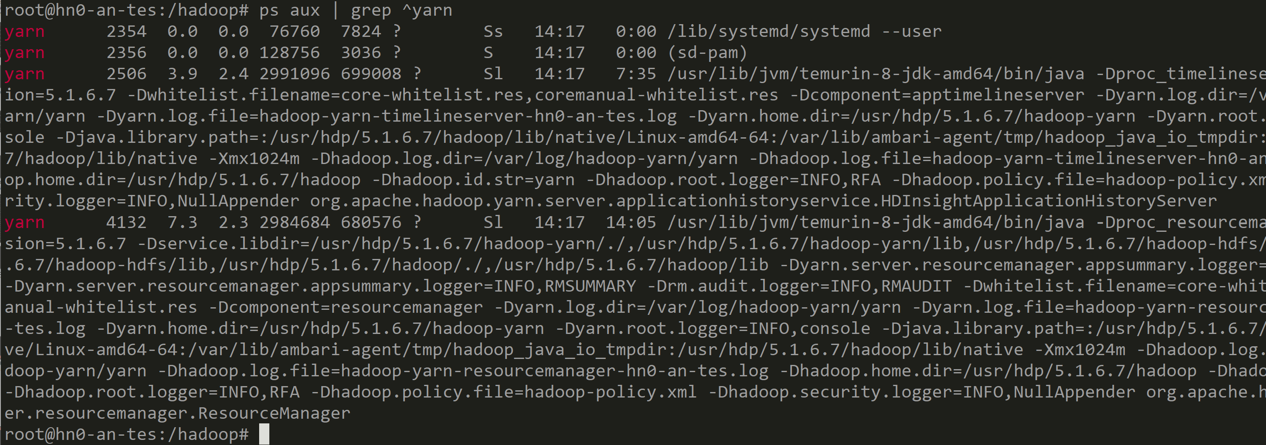
Focus on Yarn processes # sudo ps aux | grep ^yarn
We see HDInsightApplicationHistoryServer & ResourceManager

Slide 13
Yarn HN Servers logs files
for ResourceManager => see java argument ... -Dyarn.log.dir=/var/log/hadoop-yarn/yarn
root@hn0-an-tes:/var/log/hadoop-yarn/yarn# cd /var/log/hadoop-yarn/yarn
root@hn0-an-tes:/var/log/hadoop-yarn/yarn# ls -ltr
total 2076
-rw-r--r-- 1 yarn hadoop 0 Nov 11 14:17 hadoop-mapreduce.jobsummary.log
-rw-r--r-- 1 yarn hadoop 2640 Nov 11 14:18 hadoop-yarn-resourcemanager-hn0-an-tes.out
-rw-r--r-- 1 yarn hadoop 117503 Nov 11 14:18 hadoop-yarn-resourcemanager-hn0-an-tes.log
-rw-r--r-- 1 yarn hadoop 257 Nov 11 14:18 rm-audit.log
-rw-r--r-- 1 yarn hadoop 49309 Nov 11 16:49 hadoop-yarn-timelineserver-hn0-an-tes.out
-rw-r--r-- 1 yarn hadoop 1940054 Nov 11 17:32 hadoop-yarn-timelineserver-hn0-an-tes.log

Slide 14
Sample ResourceManager Logs
# less /var/log/hadoop-yarn/yarn/hadoop-yarn-resourcemanager-hn0-an-tes.log
2024-11-11 14:17:49,421 INFO resourcemanager.ResourceManager - STARTUP_MSG:
/************************************************************
STARTUP_MSG: Starting ResourceManager
STARTUP_MSG: host = hn0-an-tes/10.0.0.16
STARTUP_MSG: args = []
STARTUP_MSG: version = 3.3.4.5.1.6.7
STARTUP_MSG: classpath = /usr/hdp/5.1.6.7/hadoop/conf: ... (truncated)
2024-11-11 14:18:11,789 INFO ipc.Server - IPC Server Responder: starting
2024-11-11 14:18:11,797 INFO ipc.Server - IPC Server listener on 8141: starting
2024-11-11 14:18:11,804 INFO azurebfs.AbfsConfiguration - AbfsClientRetryPolicy: default
2024-11-11 14:18:11,812 INFO conf.Configuration - found resource yarn-site.xml at file:/etc/hadoop/5.1.6.7/0/yarn-site.xml
2024-11-11 14:18:11,898 INFO resourcemanager.ResourceManager - Already in standby state

Slide 15
Sample ResourceManager Logs on Container
# less /var/log/hadoop-yarn/yarn/hadoop-yarn-resourcemanager-hn0-an-tes.log
.... (truncated)
2024-11-11 14:23:16,376 INFO capacity.CapacityScheduler - Allocation proposal accepted
2024-11-11 14:23:16,427 INFO rmcontainer.RMContainerImpl - container_1731334645766_0003_01_000002 Container
Transitioned from ALLOCATED to ACQUIRED
2024-11-11 14:23:16,428 INFO rmcontainer.RMContainerImpl - container_1731334645766_0003_01_000003 Container
Transitioned from ALLOCATED to ACQUIRED
2024-11-11 14:23:16,874 INFO rmcontainer.RMContainerImpl - container_1731334645766_0003_01_000002 Container
Transitioned from ACQUIRED to RUNNING
2024-11-11 14:23:16,875 INFO rmcontainer.RMContainerImpl - container_1731334645766_0003_01_000003 Container
Transitioned from ACQUIRED to RUNNING
2024-11-11 14:23:17,489 INFO scheduler.AppSchedulingInfo - checking for deactivate of application :application_1731334645766_0003
2024-11-11 14:23:35,003 INFO rmcontainer.RMContainerImpl - container_1731334645766_0003_01_000002 Container
Transitioned from RUNNING to COMPLETED

Slide 16
Exploring Shell > Hdfs commands

Slide 17
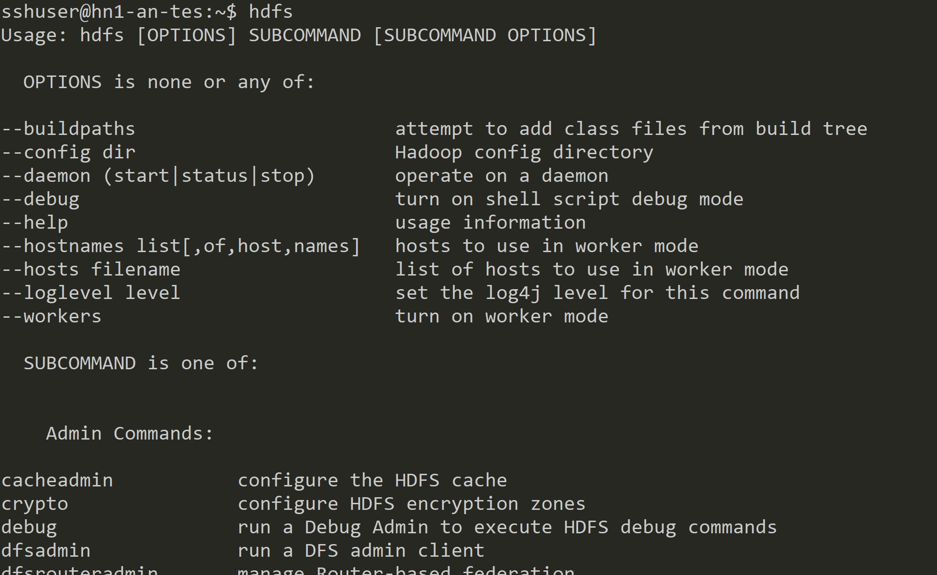
$ hdfs

Slide 18
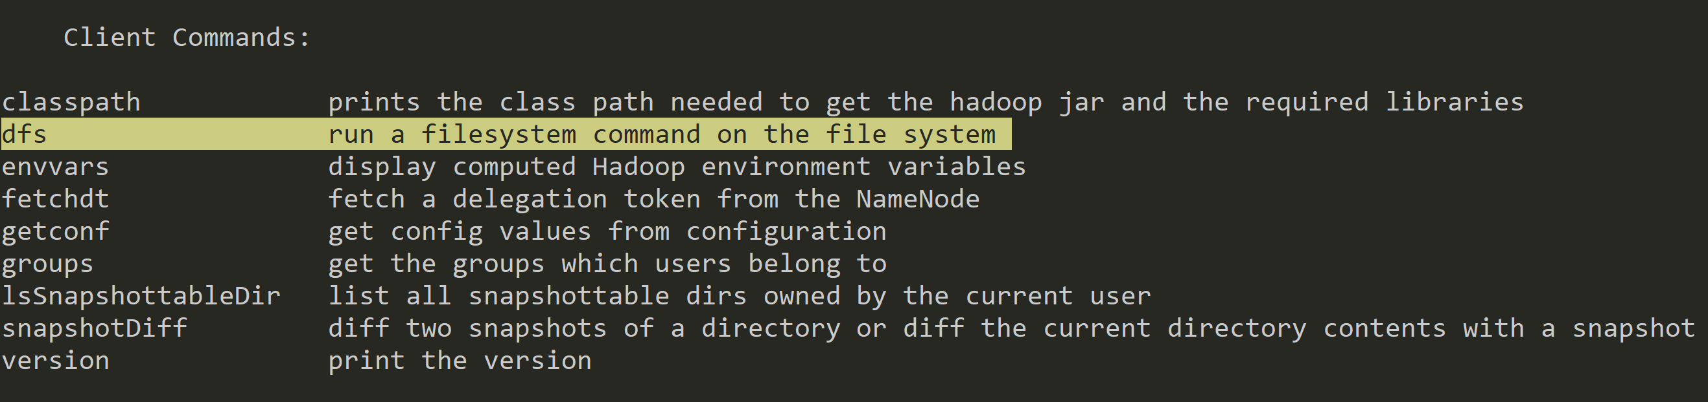
$ Hdfs dfs

Slide 19
$ hdfs dfs help <<subcommand>>
$ hdfs dfs -help ls
-ls [-C] [-d] [-h] [-q] [-R] [-t] [-S] [-r] [-u] [-e] [<path> ...] :
List the contents that match the specified file pattern. If path is not
specified, the contents of /user/<currentUser> will be listed. For a directory a
list of its direct children is returned (unless -d option is specified).
Directory entries are of the form: permissions - userId groupId sizeOfDirectory(in bytes) modDate directoryName
and file entries are of the form: permissions numberOfReplicas userId groupId sizeOfFile(in bytes) modDate fileName
-C Display the paths of files and directories only.
-d Directories are listed as plain files.
-h Formats the sizes of files in a human-readable fashion rather than a number of bytes.
-q Print ? instead of non-printable characters.
-R Recursively list the contents of directories.
-t Sort files by modification time (most recent first).
-S Sort files by size.
-r Reverse the order of the sort.
-u Use time of last access instead of modification for display and sorting.
-e Display the erasure coding policy of files and directories.

Slide 20
Focus on main "hdfs dfs " commands
$ hdfs dfs
Usage: hadoop fs [generic options]
-put [-f] <localsrc> ... <dst>
-get [-f] <src> ... <localdst>
-ls [-C] [-d] [-h] [-R] [<path> ...
-count <path> ...
-find <path> ... <expression> ...
-cp [-f] [-d] <src> ... <dst>
-mv <src> ... <dst>
-rm [-f] [-r] <src> ...
-rmdir <dir> ...
-mkdir <path>

Slide 21
sudo hdfs dfs -ls /
sshuser@hn1-an-tes:~$ sudo su hdfs
hdfs@hn1-an-tes:/home/sshuser$ hdfs dfs -ls /
Found 19 items
-rwxrwxrwx 1 hdfs hadoop 0 2024-11-11 14:02 /HDInsight_TestAccessiblityBlobName
drwxrwxrwx - hdfs hadoop 0 2024-11-11 14:17 /HdiNotebooks
drwxrwxrwx - hdfs hadoop 0 2024-11-11 14:22 /HdiSamples
drwxrwxrwx - hdfs hadoop 0 2024-11-11 14:03 /ams
drwxrwxrwx - hdfs hadoop 0 2024-11-11 14:03 /amshbase
drwxrwxrwx - hdfs hadoop 0 2024-11-11 14:03 /app-logs
drwxrwxrwx - hdfs hadoop 0 2024-11-11 14:03 /apps
drwxrwxrwx - hdfs hadoop 0 2024-11-11 14:03 /atshistory
drwxrwxrwx - hdfs hadoop 0 2024-11-11 14:22 /custom-scriptaction-logs
drwxrwxrwx - hdfs hadoop 0 2024-11-11 14:22 /example
drwxrwxrwx - hdfs hadoop 0 2024-11-11 14:03 /hbase
drwxrwxrwx - hdfs hadoop 0 2024-11-11 14:03 /hdp
drwxrwxrwx - hdfs hadoop 0 2024-11-11 14:03 /hive
drwxrwxrwx - hdfs hadoop 0 2024-11-11 14:03 /mapred
drwxrwxrwx - hdfs hadoop 0 2024-11-11 14:03 /mr-history
drwxrwxrwx - hdfs hadoop 0 2024-11-11 14:03 /tmp
drwxrwxrwx - hdfs hadoop 0 2024-11-11 14:03 /user
drwxrwxrwx - hdfs hadoop 0 2024-11-11 14:03 /warehouse
drwxrwxrwx - hdfs hadoop 0 2024-11-11 14:17 /yarn

Slide 22
$ hdfs dfs -mkdir $ hdfs dfs -put | -get | -cat | ..
h$ hdfs dfs -mkdir /user/test1
$ hdfs dfs -ls /user/test1
$ echo "Hello Hdfs, here is a file" > test-file.txt
$ hdfs dfs -put test-file.txt /user/test1/test-file.txt
$ hdfs dfs -ls /user/test1
Found 1 items
-rwxrwxrwx 1 hdfs hadoop 27 2024-11-11 18:05 /user/test1/test-file.txt
$ hdfs dfs -cat /user/test1/test-file.txt
Hello Hdfs, here is a file
$ hdfs dfs -get /user/test1/test-file.txt test-file2.txt

Slide 23
Hdfs command : using implicitly "fs.defaultFS"
hdfs@hn1-an-tes:~$ cat /etc/hadoop/conf/core-site.xml | grep -C3 fs.defaultF
</property>
<property>
<name>fs.defaultFS</name>
<value>abfss://an-test-hdi4-2024-11-11t14-01-25-666z@teststoragehdifrance.dfs.core.windows.net</value>
<final>true</final>
</property>

Slide 24
Explicit command : $ hdfs dfs -ls abfss://
$ hdfs dfs -ls abfss://an-test-hdi4-2024-11-11t14-01-25-666z@teststoragehdifrance.dfs.core.windows.net/user/test1
Found 1 items
-rwxrwxrwx 1 hdfs hadoop 27 2024-11-11 18:05 abfss://an-test-hdi4-2024-11-11t14-01-25-666z@teststoragehdifrance.dfs.core.windows.net/user/test1/test-file.txt

Slide 25
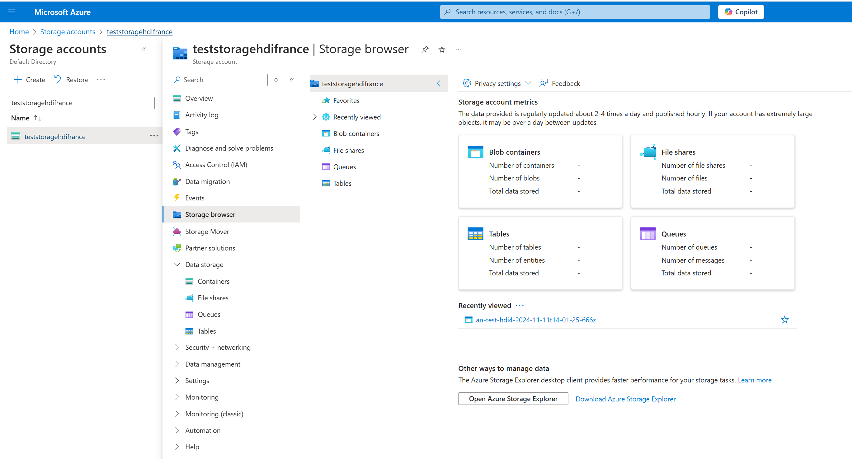
Storage Browser

Slide 26
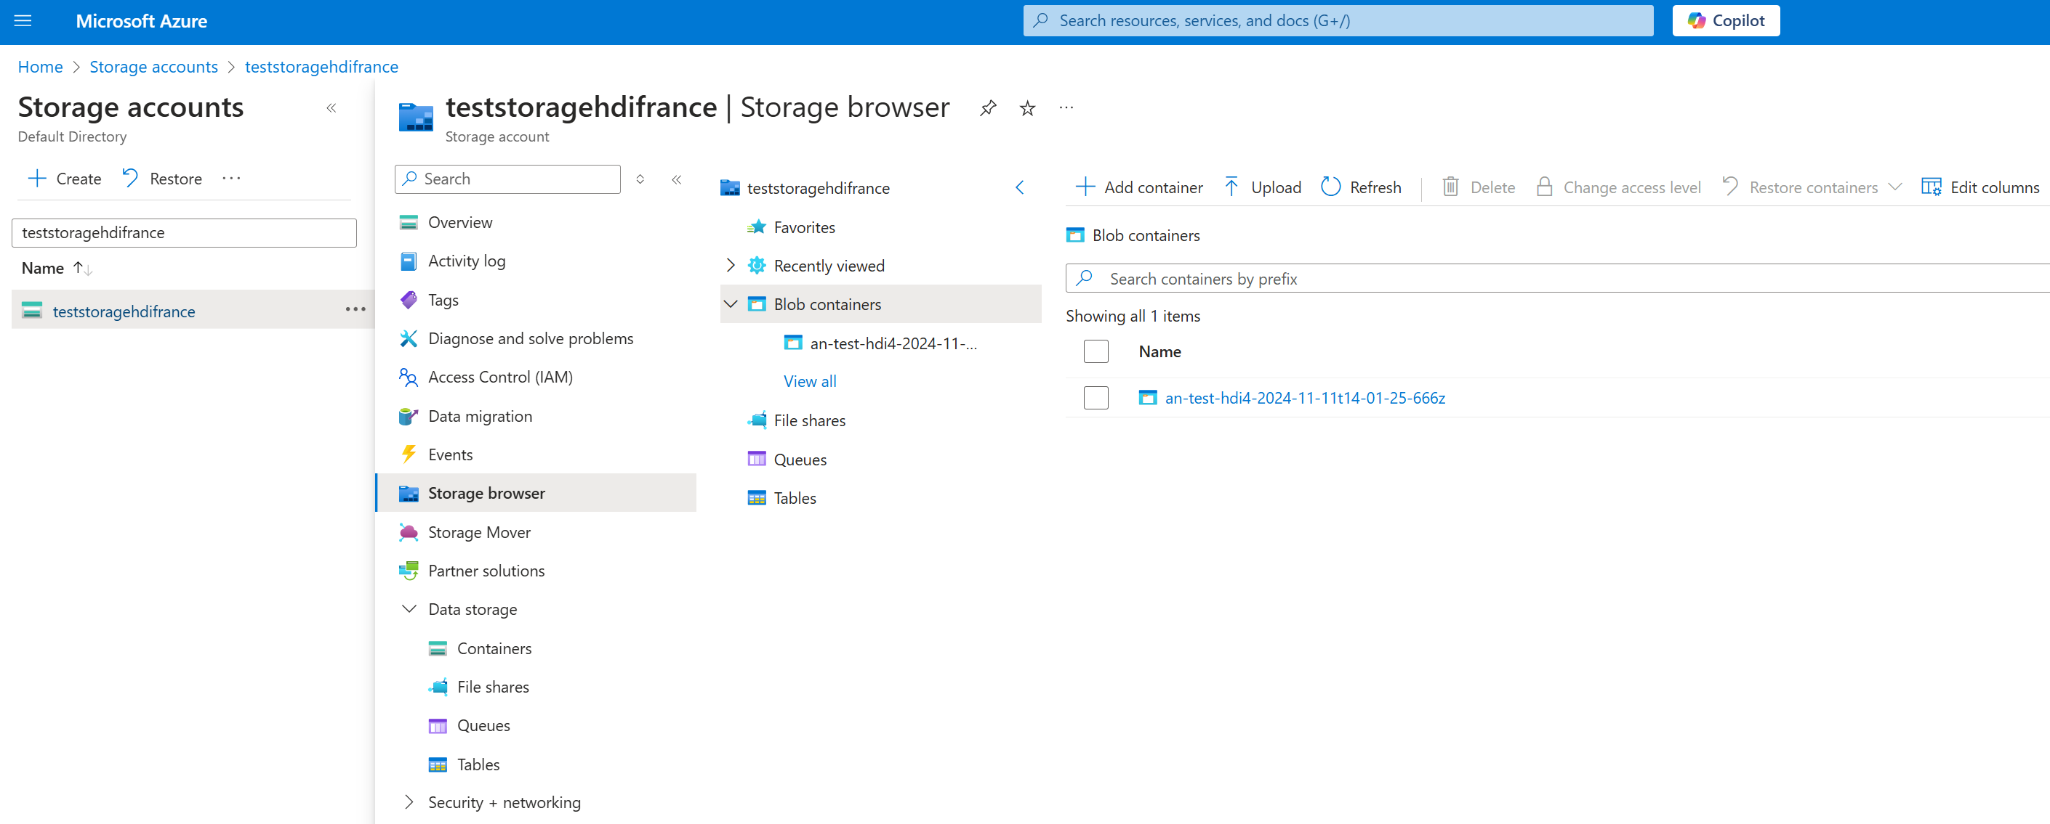
Storage > Containers > Directories > Files

Slide 27
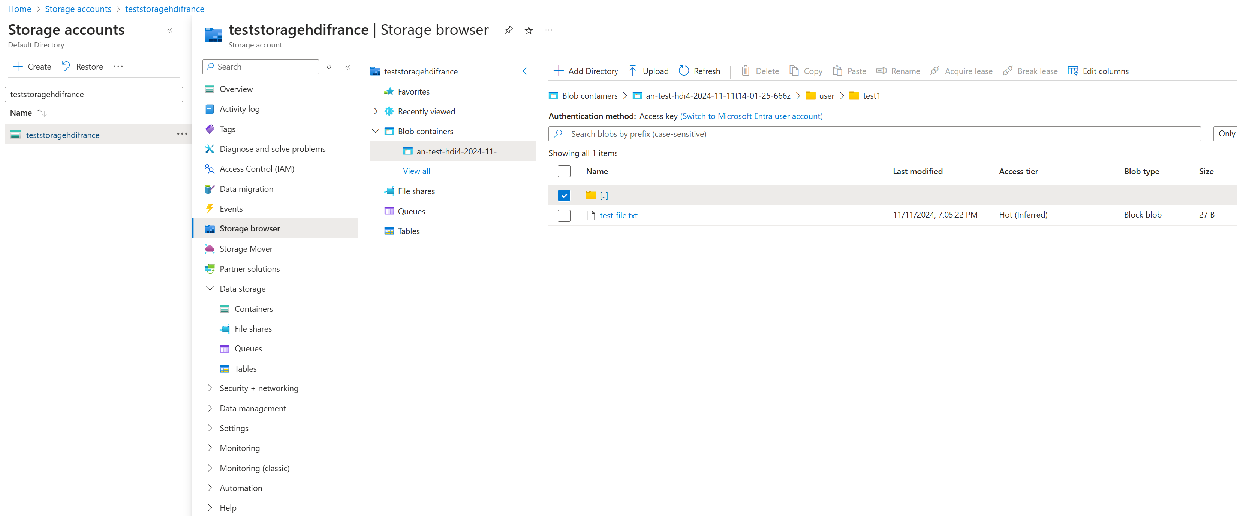
Storage Browser

Slide 28
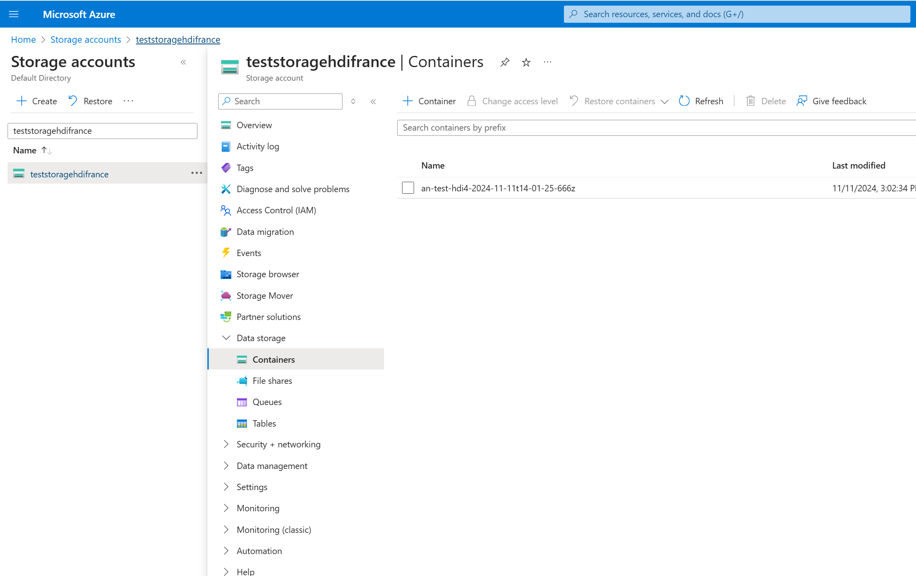
Other Interface : "Data Storage" (!= Browser)

Slide 29
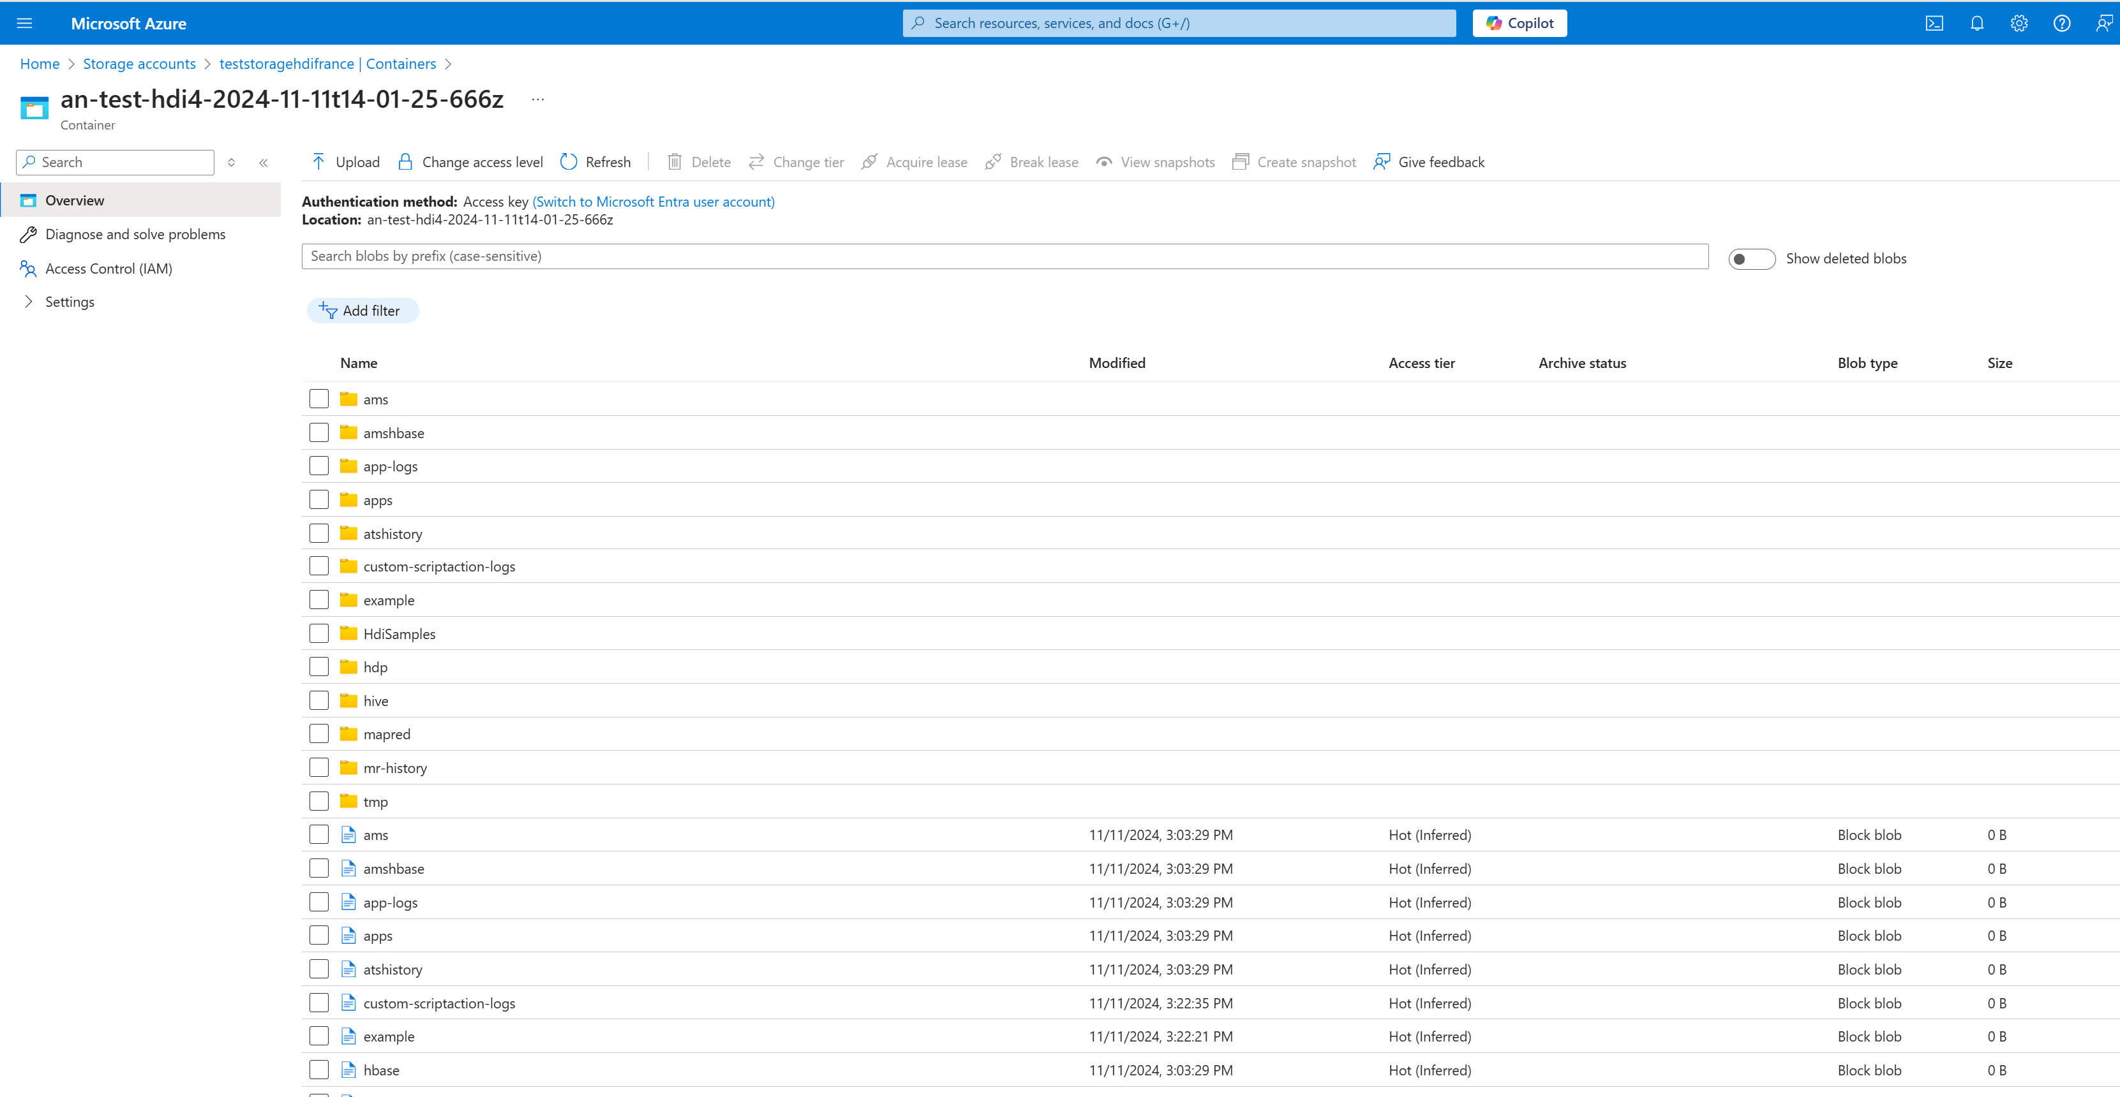
Data Explorer (redundant, and less practical than Browser)

Slide 30
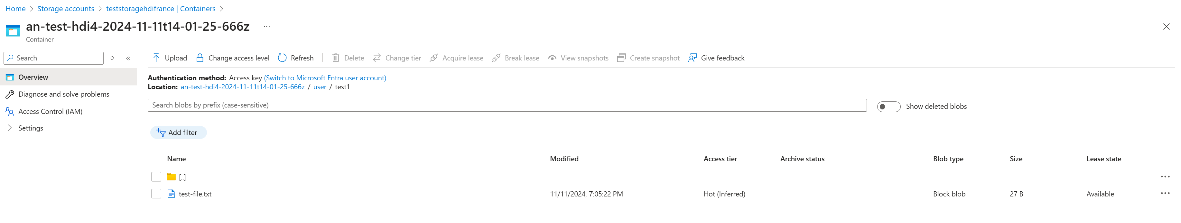
my created dir "/user/test1" ... and file "/user/test1/test-file.txt"

Slide 31
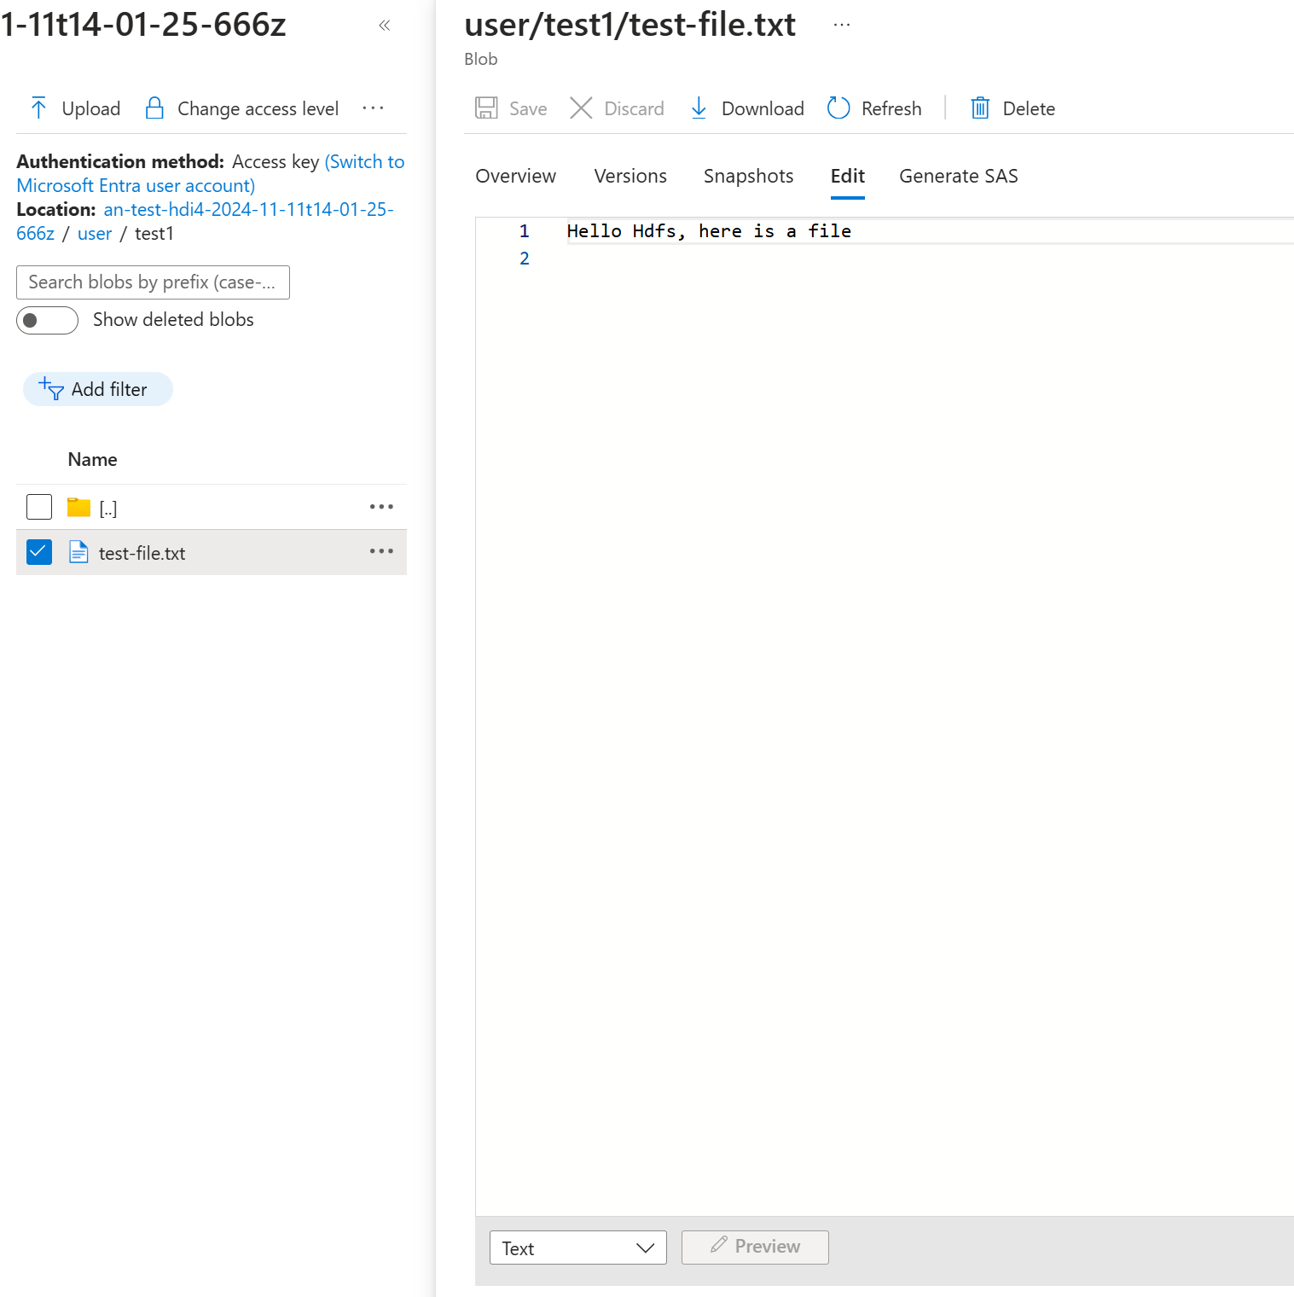
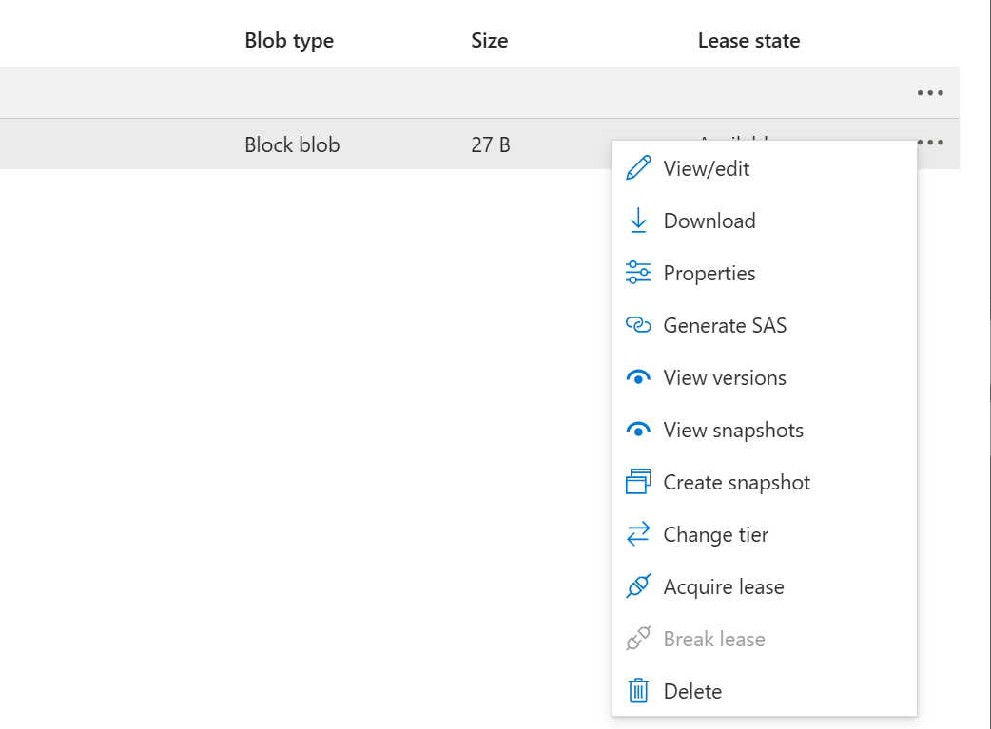
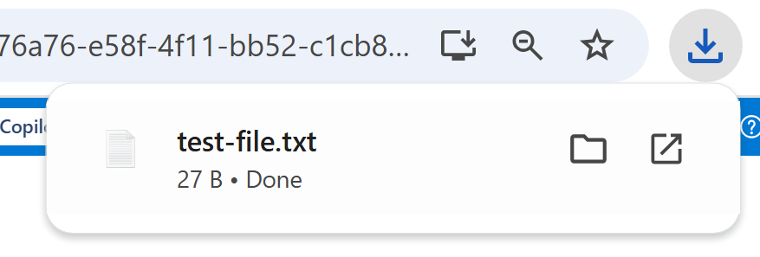
View / Download File from Portal

Slide 32
Using Shell > Yarn commands (to list / kill Jobs, not to start one !)

Slide 33
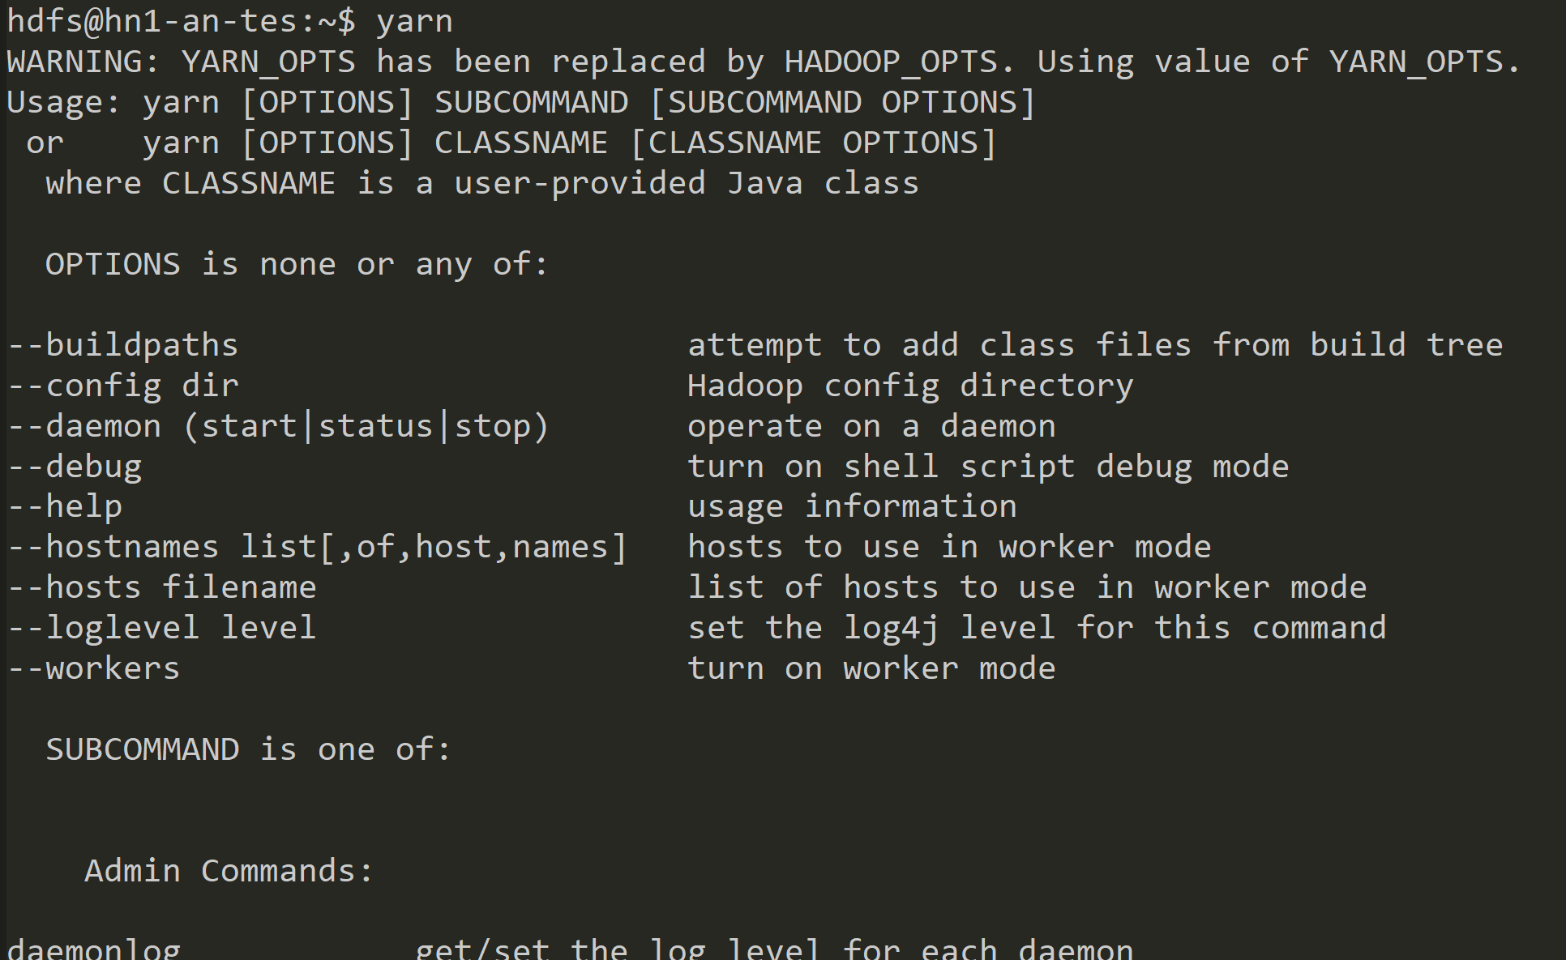
$ yarn <<sub-command>>

Slide 34
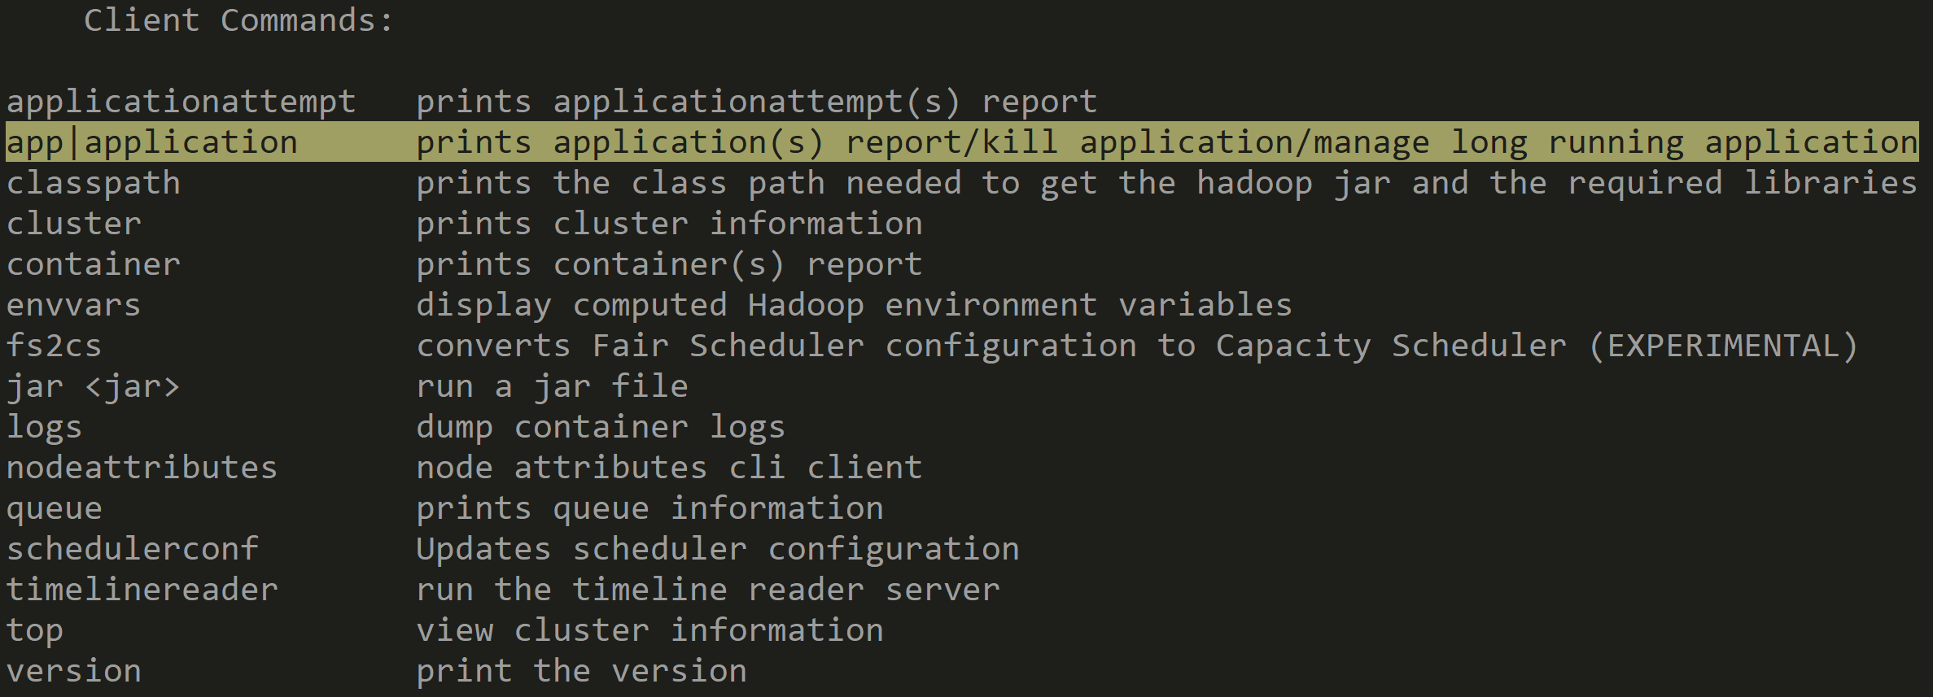
$ yarn app <<sub-app-command>>

Slide 35
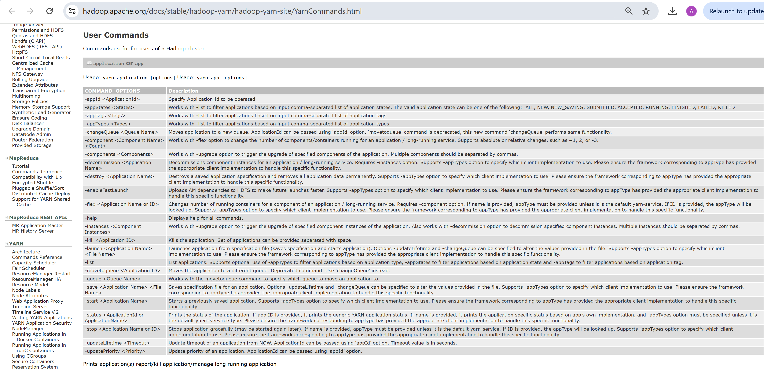
$ yarn app { -list | -status | -kill ...} see doc https://hadoop.apache.org/docs

Slide 36
$ yarn app -list
$ yarn app -list
Total number of applications (application-types: [], states: [SUBMITTED, ACCEPTED, RUNNING] and tags: []):2
Application-Id Application-Name Application-Type User Queue State
Progress Tracking-URL
application_1731334645766_0002 Thrift JDBC/ODBC Server SPARK spark thriftsvr RUNNING
UNDEFINED 10% http://hn0-an-tes.fibfli32hrrenczv02qeic3dbb.parx.internal.cloudapp.net:5040
application_1731334645766_0001 Thrift JDBC/ODBC Server SPARK spark thriftsvr RUNNING
10% http://hn1-an-tes.fibfli32hrrenczv02qeic3dbb.parx.internal.cloudapp.net:5040

Slide 37
$ yarn app -status <<app_id>>
$ yarn app -status application_1731334645766_0002
Application Report :
Application-Id : application_1731334645766_0002
Application-Name : Thrift JDBC/ODBC Server
Application-Type : SPARK
User : spark
Queue : thriftsvr
Application Priority : 0
Start-Time : 1731334779687
Finish-Time : 0
Progress : 10%
State : RUNNING
Final-State : UNDEFINED
Tracking-URL : http://hn0-an-tes.fibfli32hrrenczv02qeic3dbb.parx.internal.cloudapp.net:5040
RPC Port : -1
AM Host : 10.0.0.4
Aggregate Resource Allocation : 24100938 MB-seconds, 15690 vcore-seconds
Aggregate Resource Preempted : 0 MB-seconds, 0 vcore-seconds
Log Aggregation Status : NOT_START
Diagnostics :
Unmanaged Application : false
Application Node Label Expression : <Not set>
AM container Node Label Expression : <DEFAULT_PARTITION>
TimeoutType : LIFETIME ExpiryTime : UNLIMITED RemainingTime : -1seconds

Slide 38
$ yarn logs -applicationId <<app_id>>
$ yarn logs -applicationId application_1731334645766_0002
Container: container_1731334645766_0002_01_000001 on wn1-an-tes.fibfli32hrrenczv02qeic3dbb.parx.internal.cloudapp.net:30050
LogAggregationType: LOCAL
===========================================================================================================================
LogType:prelaunch.out
LogLastModifiedTime:Mon Nov 11 14:19:40 +0000 2024
LogLength:100
LogContents:
... (truncated)
ExecutorLauncher --arg 'hn0-an-tes.fibfli32hrrenczv02qeic3dbb.parx.internal.cloudapp.net:46739' --properties-file $PWD/__spark_conf__/__spark_conf__.properties --dist-cache-conf $PWD/__spark_conf__/__spark_dist_cache__.properties 1> /mnt/resource/hadoop/yarn/log/application_1731334645766_0002/container_1731334645766_0002_01_000001/stdout 2> /mnt/resource/hadoop/yarn/log/application_1731334645766_0002/container_1731334645766_0002_01_000001/stderr"
End of LogType:launch_container.sh.This log file belongs to a running container (container_1731334645766_0002_01_000001) and so may not be complete.
************************************************************************************

Slide 39
With Yarn ... You can NOT start a new application, ONLY restart (clone) an existing one !! It has to be > 1000 lines of java code OR using Oozie / Livy / spark-submit / ...

Slide 40
Submitting a Oozie Job

Slide 41
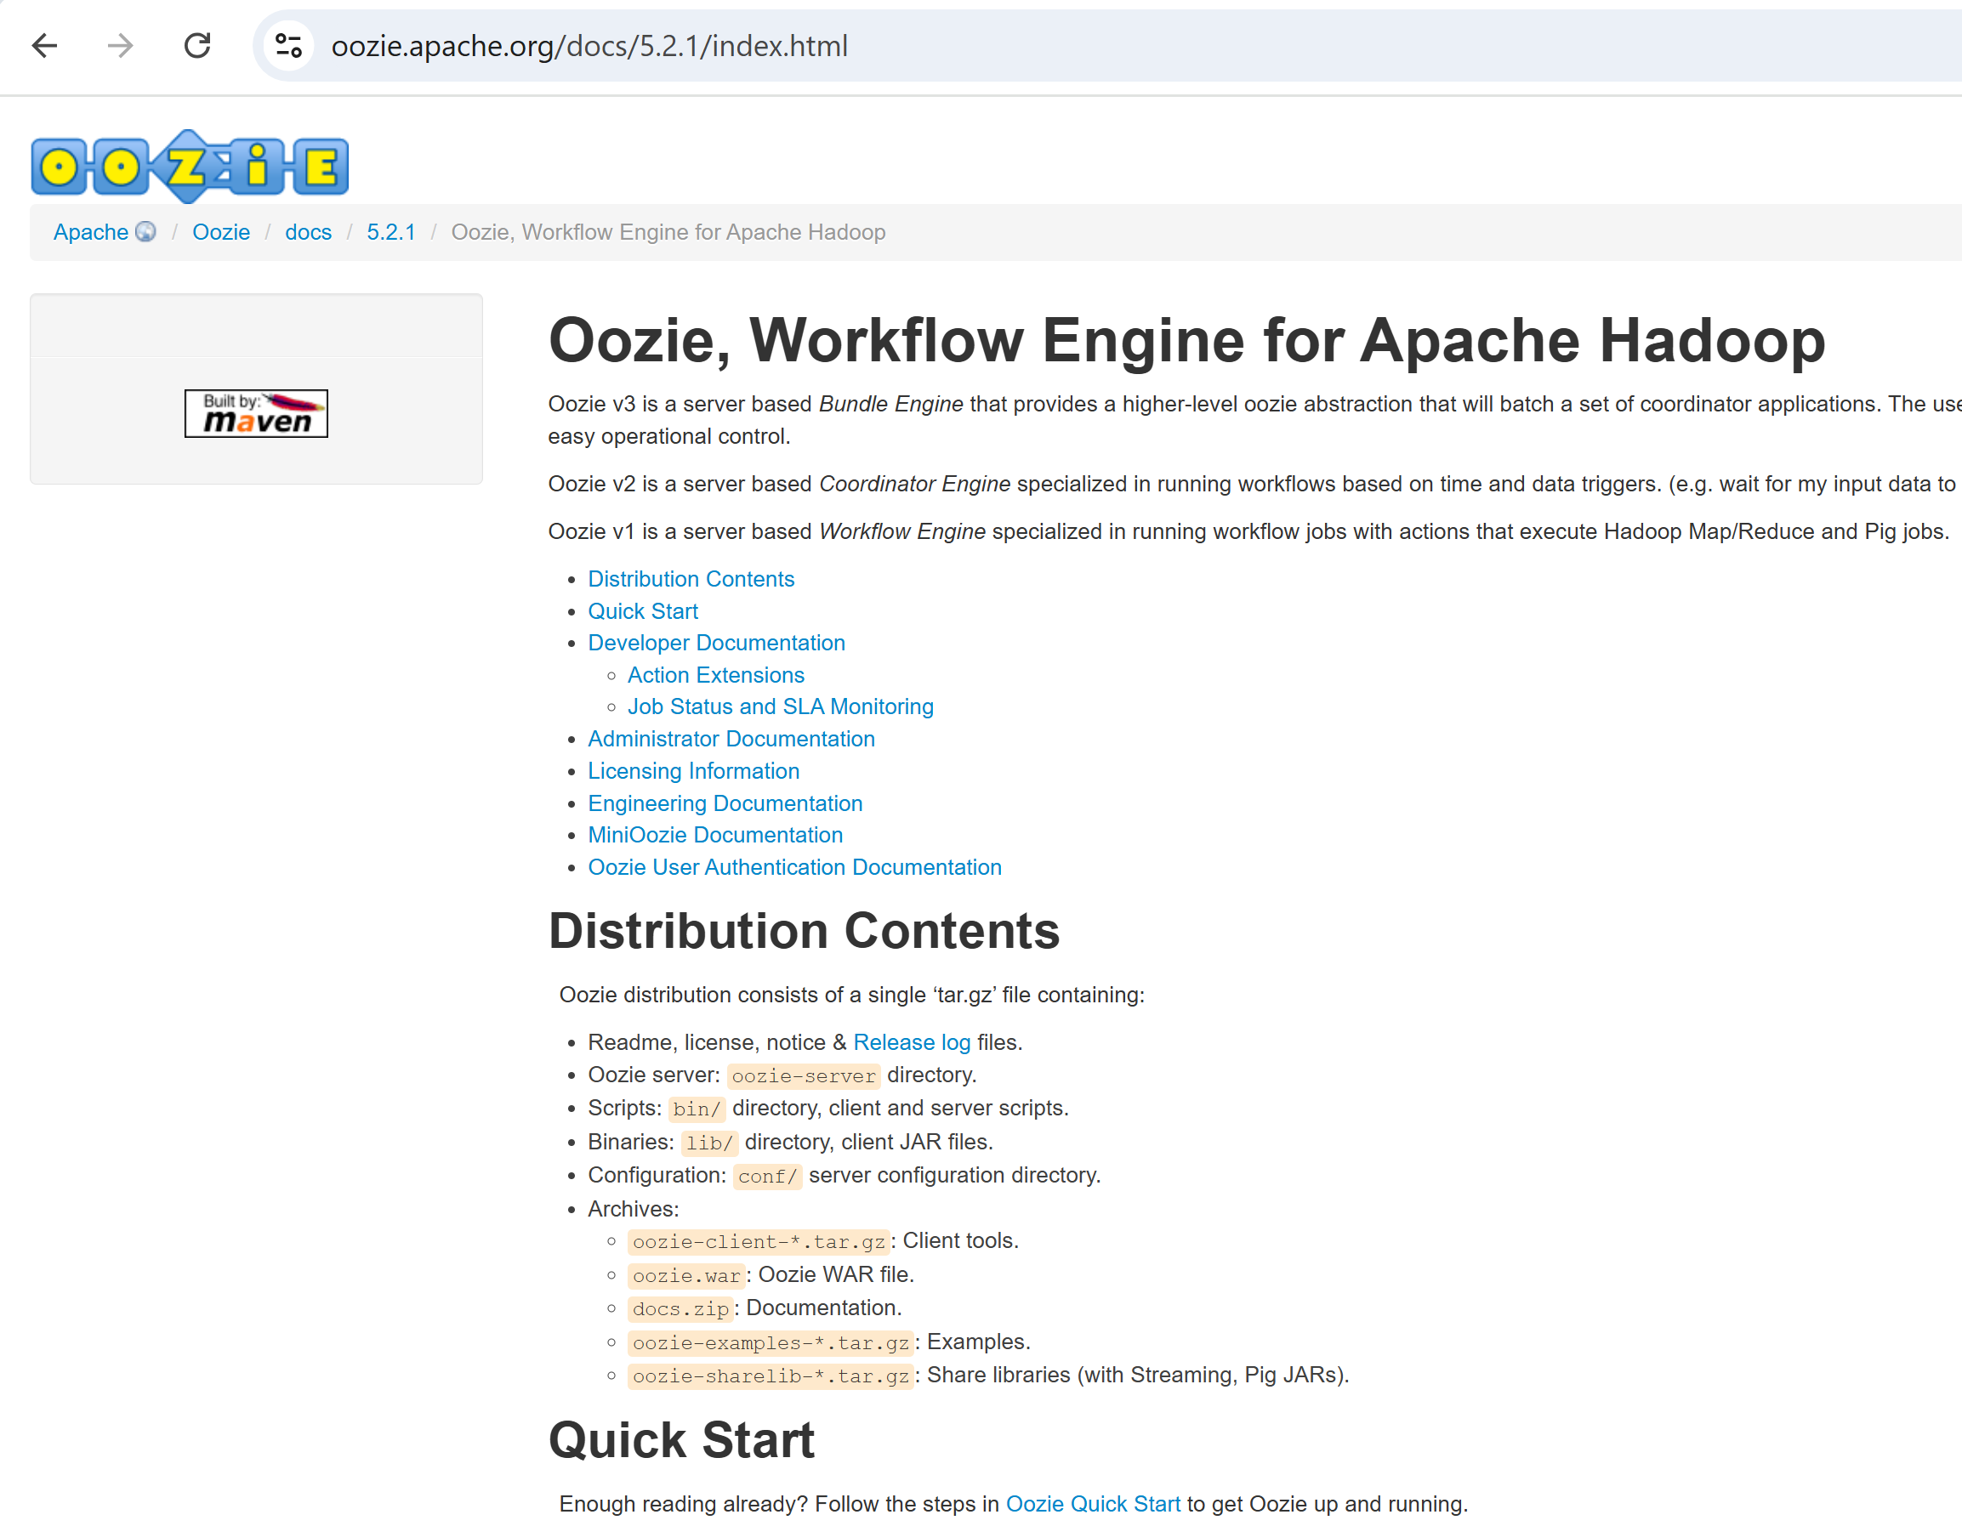
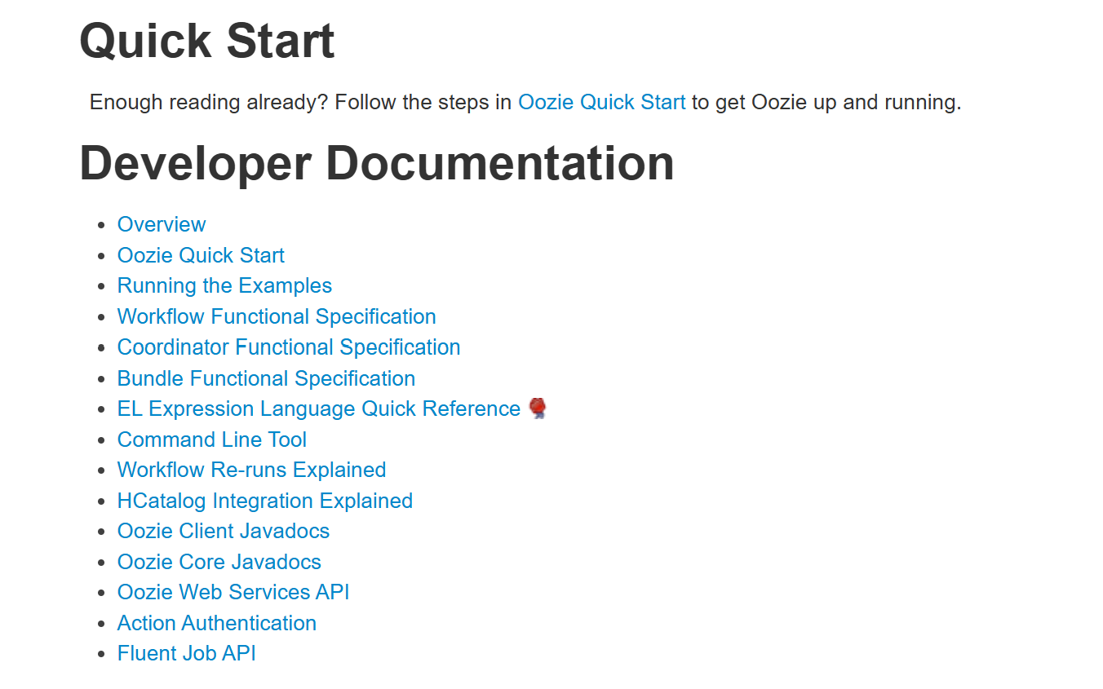
Oozie
https://oozie.apache.org/docs/5.2.1/index.html

Slide 42
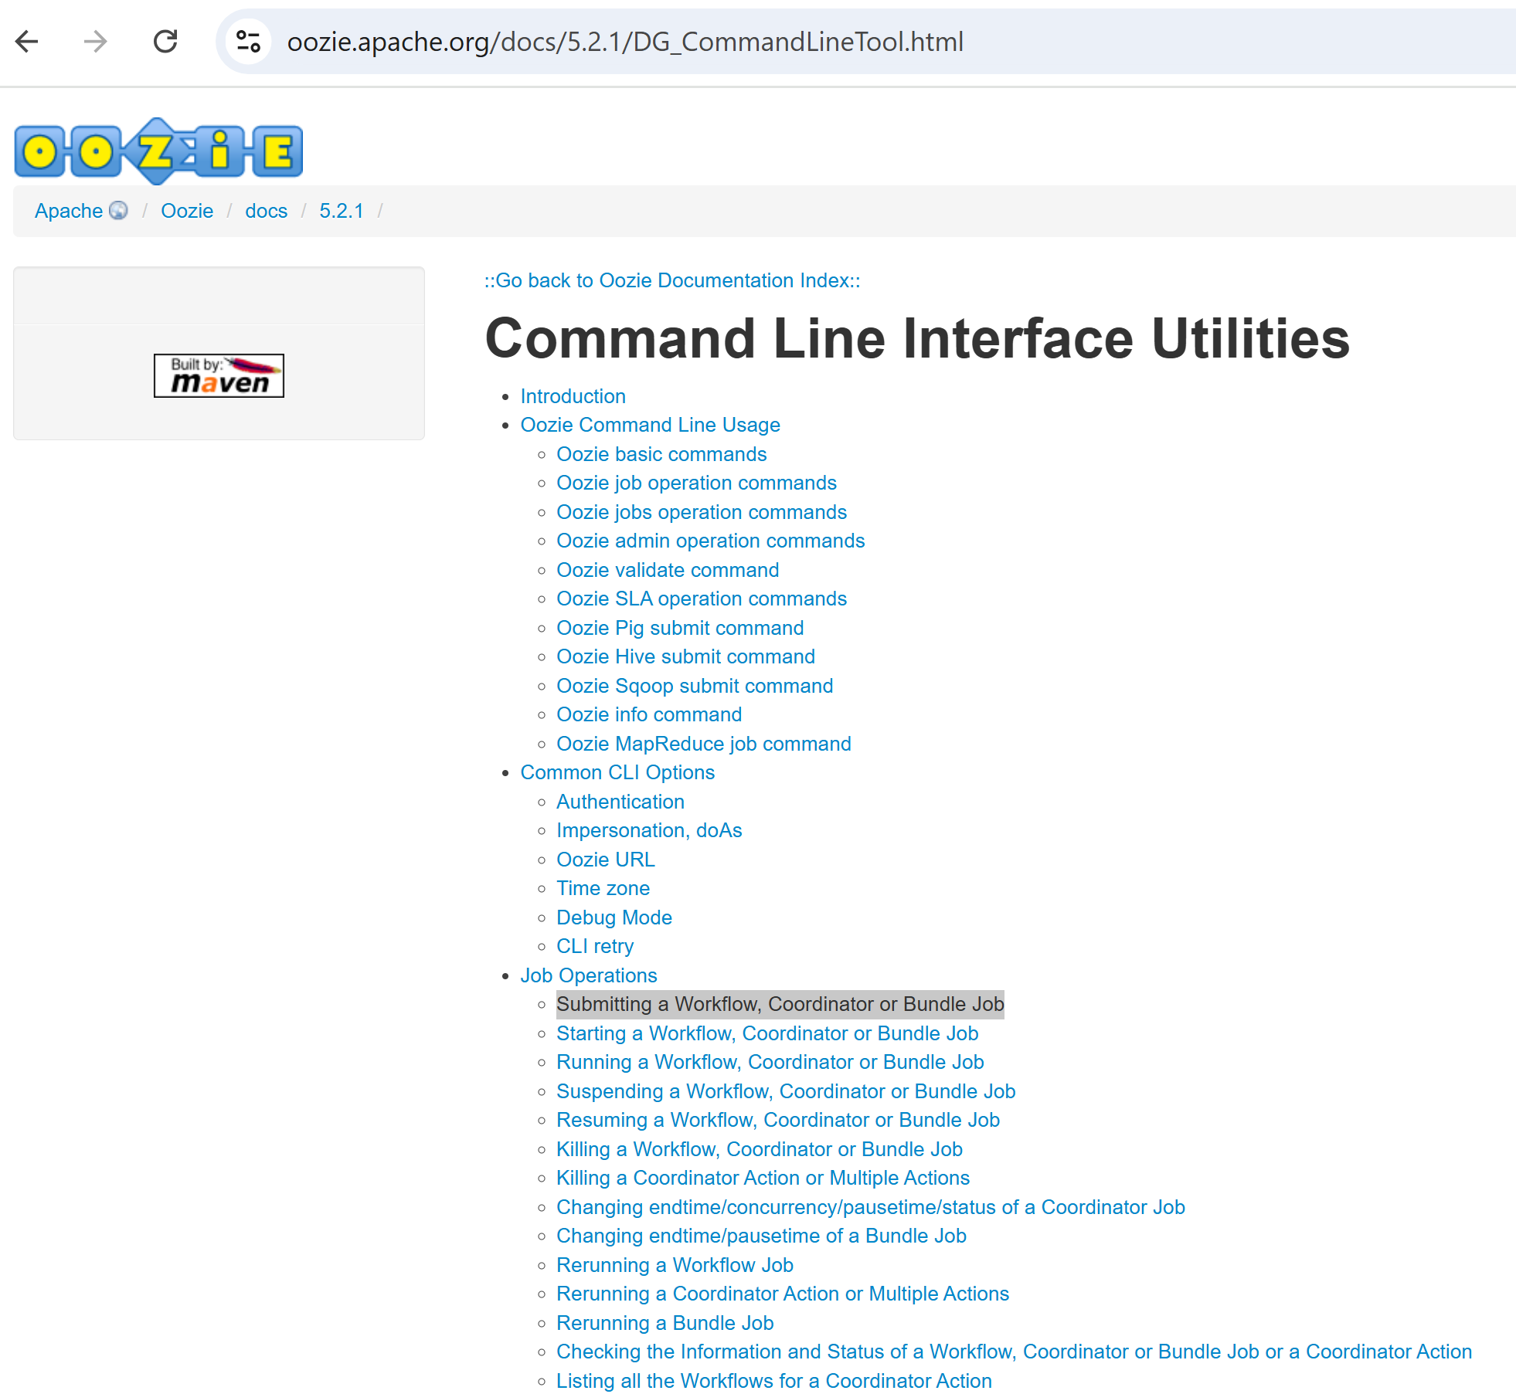
oozie Doc: Command Line Tool

Slide 43
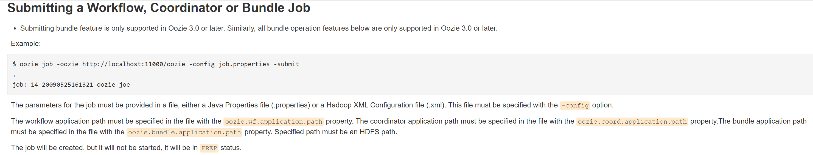
doc : $ oozie job -config job.properties -submit

Slide 44
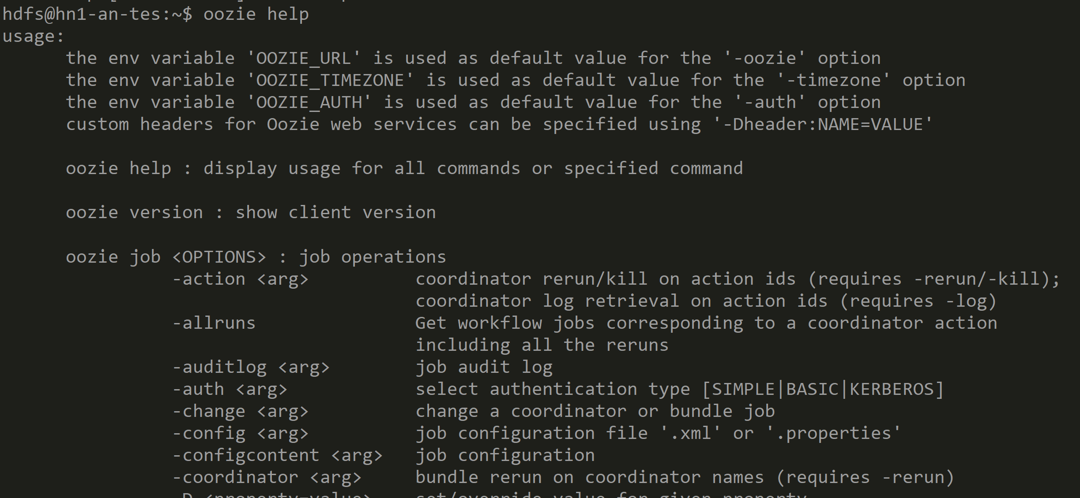
Submit Oozie workflow using command line $ oozie help

Slide 45
workflow.xml
<workflow-app name="useooziewf" xmlns="uri:oozie:workflow:0.2">
<start to="my-shell"/>
<action name='my-shell'>
<shell xmlns="uri:oozie:shell-action:0.1">
<job-tracker>${jobTracker}</job-tracker>
<name-node>${nameNode}</name-node>
<configuration>
<property>
<name>mapred.job.queue.name</name>
<value>${queueName}</value>
</property>
</configuration>
<exec>my-shell-script.sh</exec>
<argument>arg1</argument>
<argument>arg2</argument>
<file>my-shell-script.sh</file>
</shell>
<ok to="end" />
<error to="fail" />
</action>
<kill name="fail">
<message>Job failed, error message
[${wf:errorMessage(wf:lastErrorNode())}] </message>
</kill>
<end name="end"/>
</workflow-app>

Slide 46
job.properties
# cf parameter fs.defaultFS (contains oozie jars)
nameNode=abfss://an-test-hdi4-2024-11-11t14-01-25-666z@teststoragehdifrance.dfs.core.windows.net
jobTracker=headnodehost:8050
queueName=default
oozie.use.system.libpath=true
user.name=admin
# dir containing workflow.xml + referenced <file>
oozie.wf.application.path=\ abfss://an-test-hdi4-2024-11-11t14-01-25-666z@teststoragehdifrance.dfs.core.windows.net/user/test1/test-oozie-shell

Slide 47
my-shell-script.sh
#!/bin/bash
# file my-shell-script.sh
echo "executing shell script $0"
echo "using shell arguments: $*"
for i in $(seq 1 6);
do
echo "step [$i/6] sleep 10"
sleep 10
done
echo "Finish shell script ==> exit 0"
exit 0

Slide 48
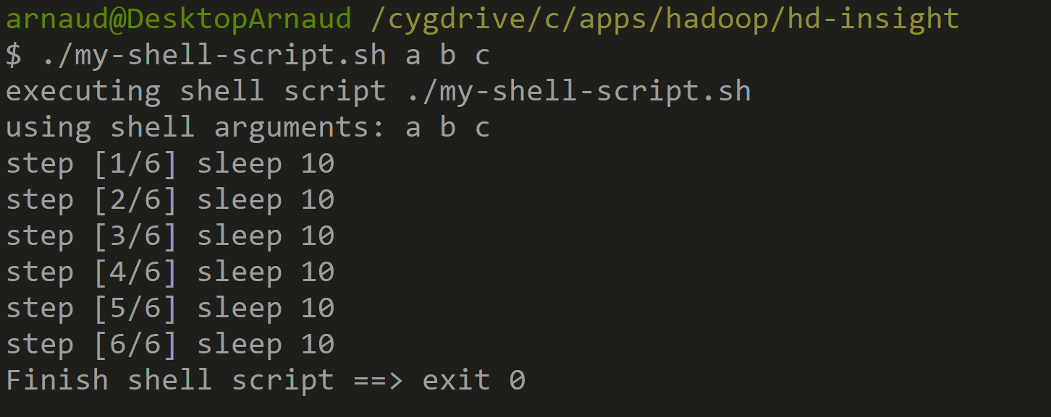
Testing locally "my-shell-script.sh"

Slide 49
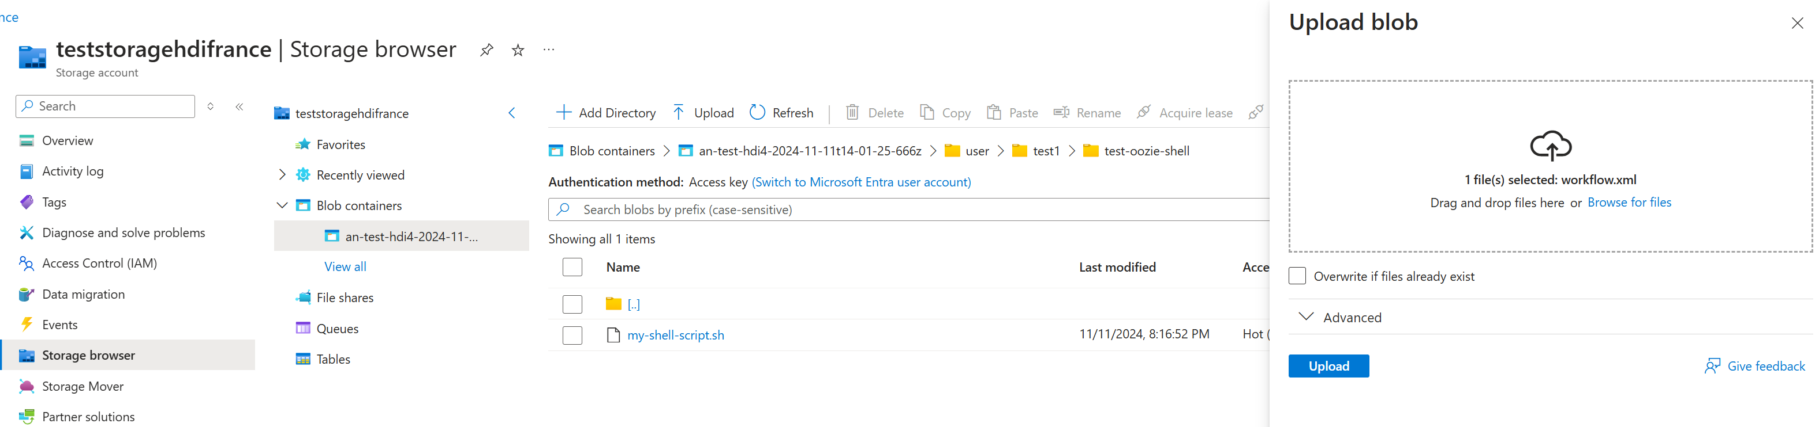
Deploying workflow.xml + my-shell-script.sh to abfss://...

Slide 50
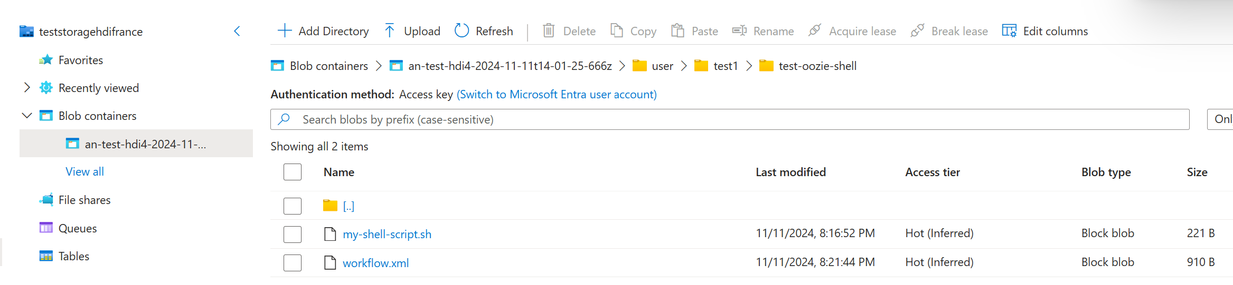
Checking before deployment
$ hdfs dfs -ls /user/test1/test-oozie-shell
Found 2 items
-rwxrwxrwx 1 hdfs hadoop 221 2024-11-11 19:16 /user/test1/test-oozie-shell/my-shell-script.sh
-rwxrwxrwx 1 hdfs hadoop 910 2024-11-11 19:21 /user/test1/test-oozie-shell/workflow.xml

Slide 51
Testing before submit ...
$ hdfs dfs -cat /user/test1/test-oozie-shell/workflow.xml
<workflow-app name="useooziewf" xmlns="uri:oozie:workflow:0.2">
<start to="my-shell"/>
<action name='my-shell'>
<shell xmlns="uri:oozie:shell-action:0.1">
...
$ hdfs dfs -get /user/test1/test-oozie-shell/my-shell-script.sh
$ chmod u+x ./my-shell-script.sh
$ ./my-shell-script.sh a b c
executing shell script ./my-shell-script.sh
using shell arguments: a b c
step [1/6] sleep 10

Slide 52
$ oozie job -config job.properties -submit
$ oozie job -config job.properties -submit
SLF4J: Class path contains multiple SLF4J bindings.
SLF4J: Found binding in [jar:file:/usr/hdp/5.1.6.7/oozie/libext/slf4j-reload4j-1.7.35.jar!/org/slf4j/impl/StaticLoggerBinder.class]
SLF4J: Found binding in [jar:file:/usr/hdp/5.1.6.7/oozie/embedded-oozie-server/webapp/WEB-INF/lib/slf4j-reload4j-1.7.35.jar!/org/slf4j/impl/StaticLoggerBinder.class]
SLF4J: See http://www.slf4j.org/codes.html#multiple_bindings for an explanation.
SLF4J: Actual binding is of type [org.slf4j.impl.Reload4jLoggerFactory]
job: 0000000-241111142139172-oozie-oozi-W

Slide 53
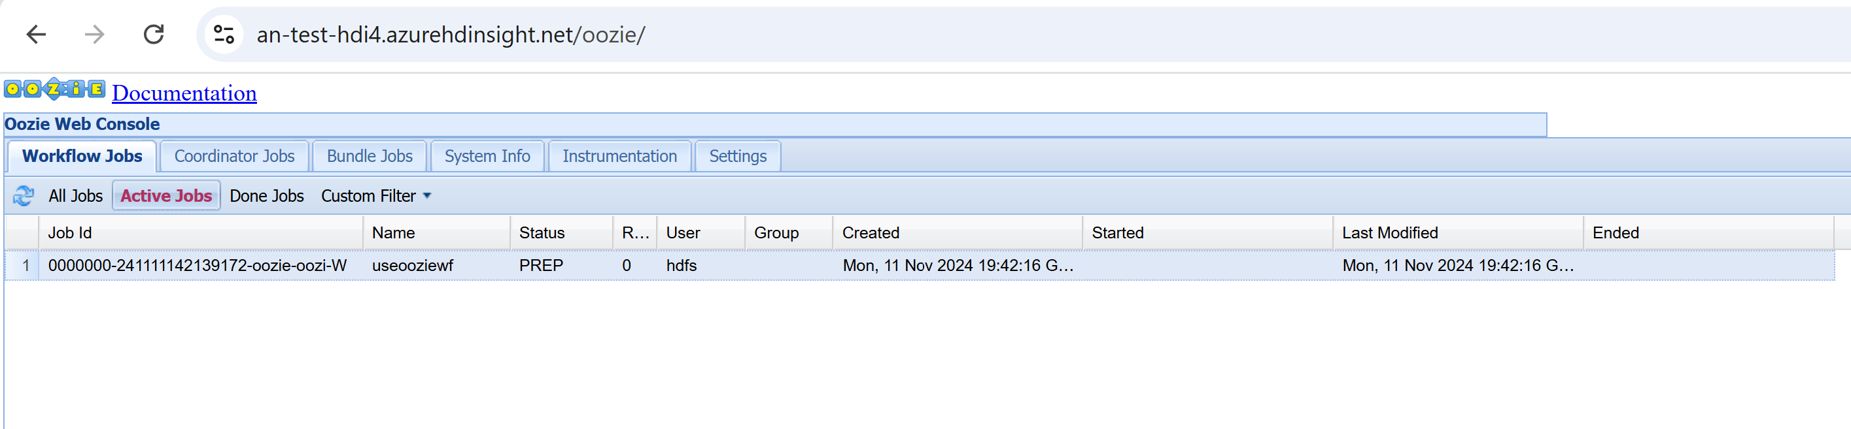
Checking running Job in Oozie UI
FAIL .... stay in "PREPARED" mode forever !! (wrong config)

Slide 54
sshuser ... can not be authenticated/impersonnated by oozie ?!
$ sudo adduser sshuser users
Adding user `sshuser' to group `users' ...
Adding user sshuser to group users
Done.

Slide 55
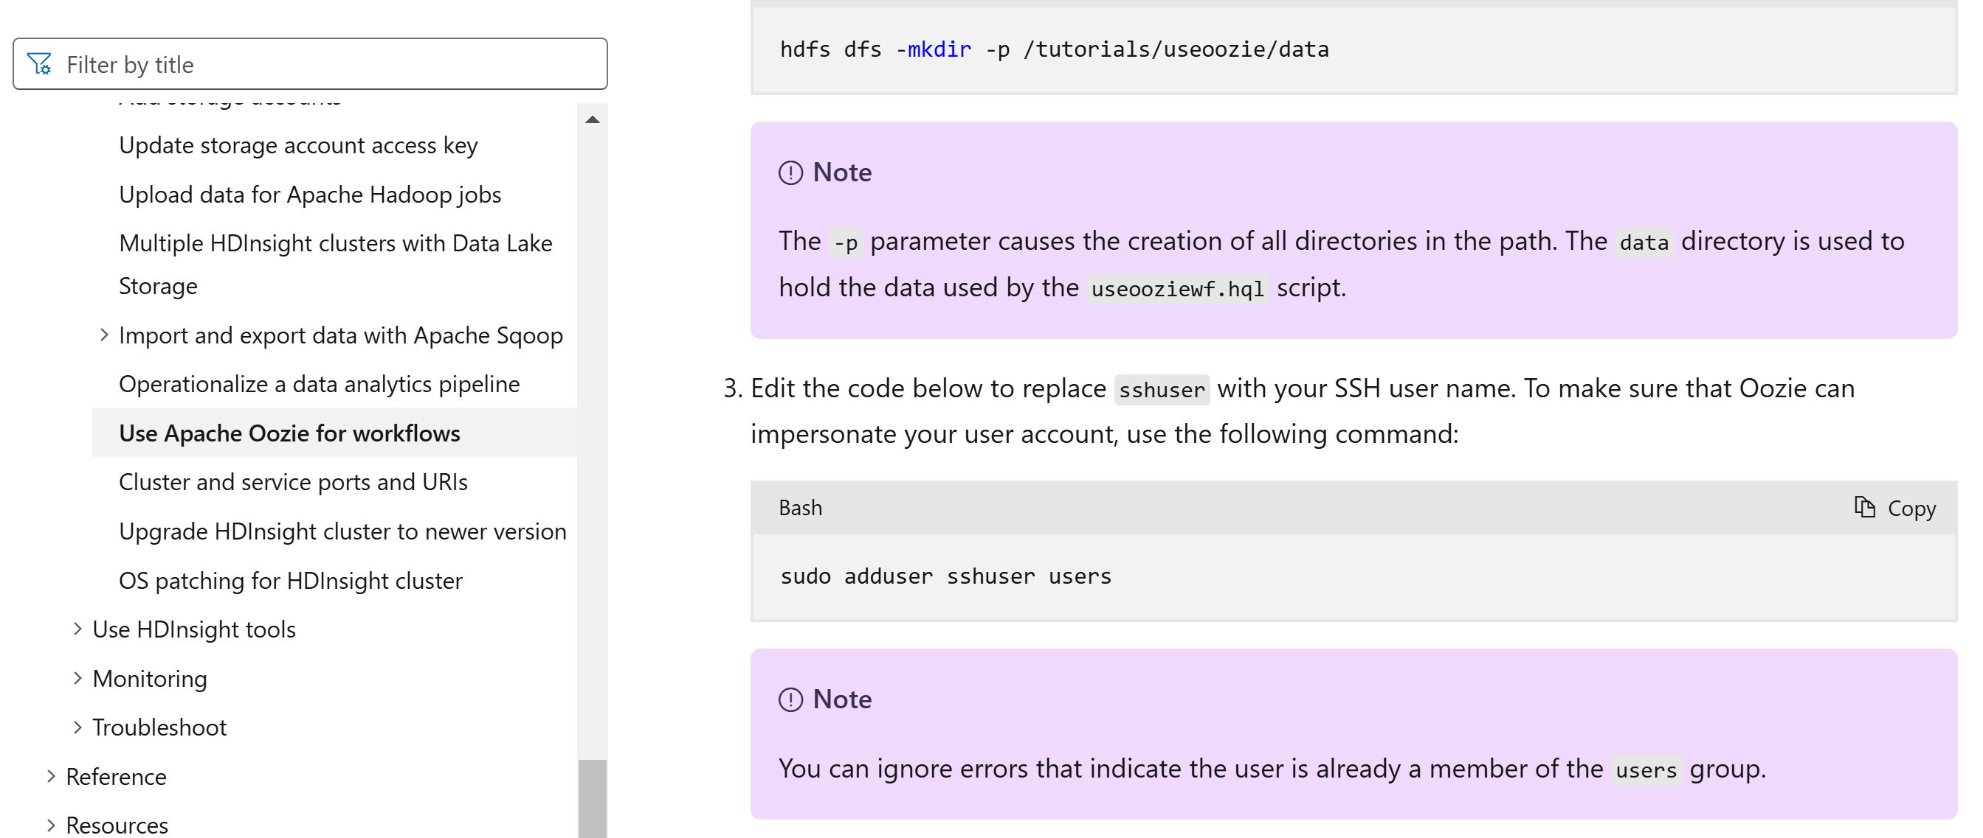
cf doc https://learn.microsoft.com/en-us/azure/hdinsight/hdinsight-use-oozie-linux-mac

Slide 56
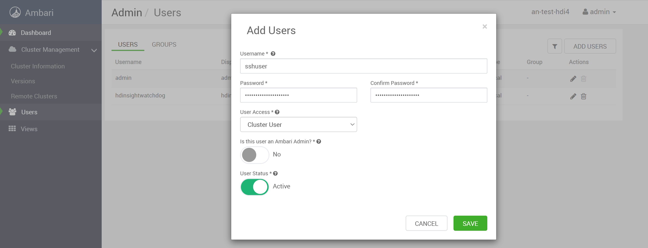
Trying to add user

Slide 57
login in Ambari for this user

Slide 58
using Oozie via Http Rest API + curl
$ export PASSWORD="..."
$ curl -u admin:$PASSWORD https://an-test-hdi4.azurehdinsight.net/oozie/versions
[0,1,2]

Slide 59
submit Oozie via Http curl -X POST
$ export PASSWORD="..."
$ curl -u admin:$PASSWORD https://an-test-hdi4.azurehdinsight.net/oozie/v1/job -d config.xml

Slide 60
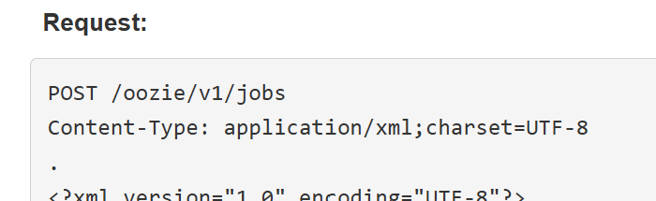

WARN ... Oozie POST => PREPARE mode
https://oozie.apache.org/docs/5.0.0/WebServicesAPI.html#Job_Submission
Looks simple ... BUT WARN !!!
You need explicitly to POST /api/v1/ jobs?action=start

Slide 61

Unfinished document
More to do:
- oozie
- livy
- spark-submit
...

Slide 62
Questions ?
arnaud.nauwynck@gmail.com

